Slide 1
WISE Images – Comet Siding Spring

Slide 2
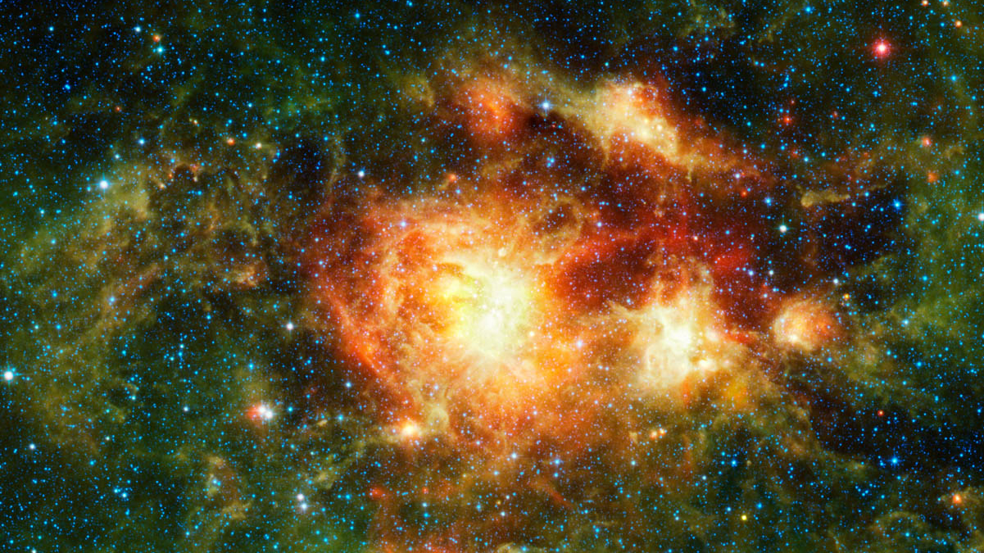
WISE Images – NGC 3603

Slide 3
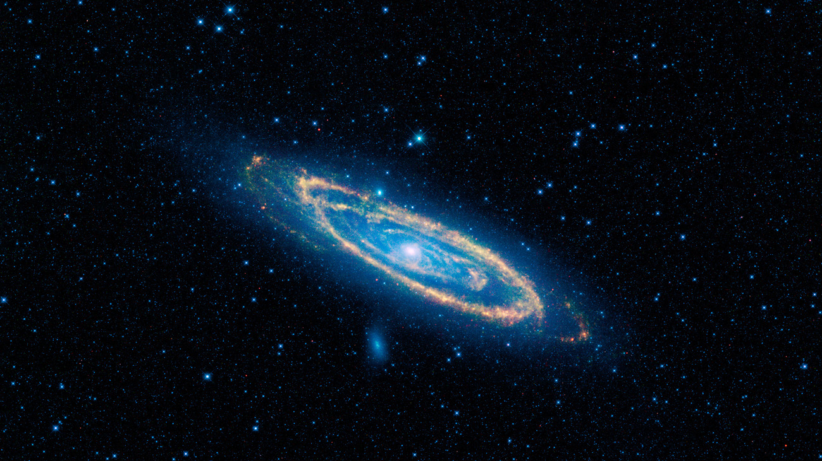
WISE Images – Andromeda Galaxy

Slide 4
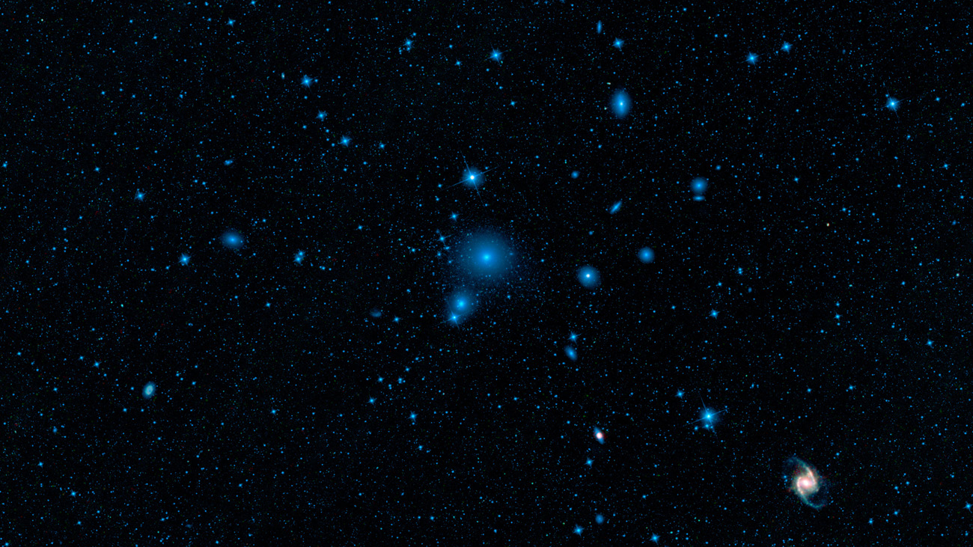
WISE Images – Fornax Galaxy Cluster

Slide 5
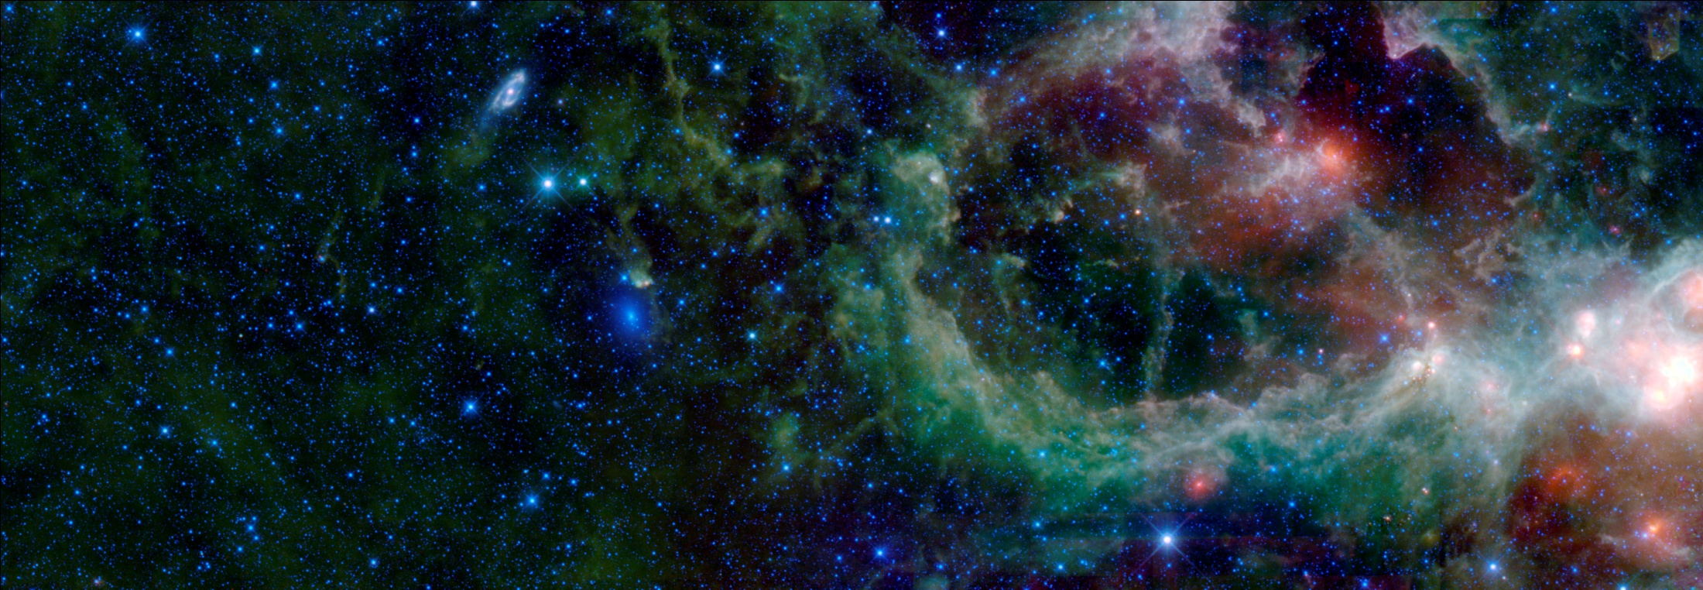
WISE Images – Maffei 1 & 2 with the Heart Nebula

Slide 6
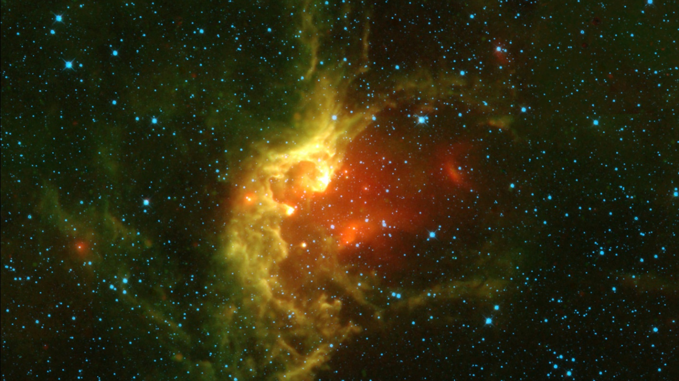
WISE Images – The Wizard Nebula

Slide 7
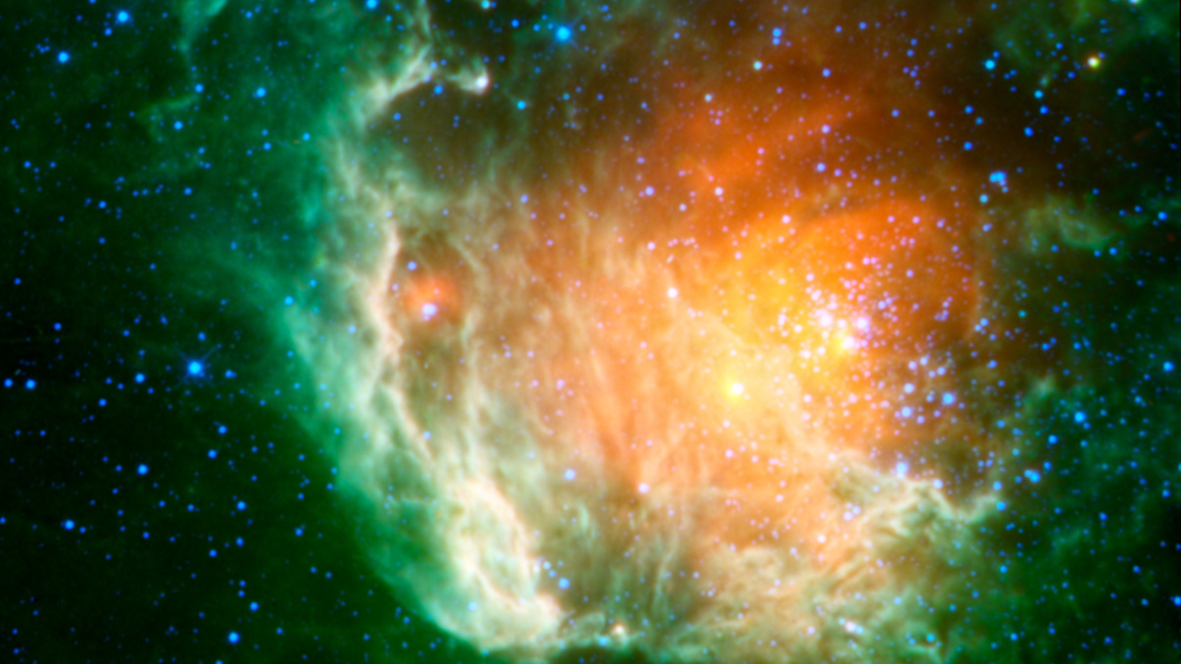
WISE Images – Berkeley 59

Slide 8
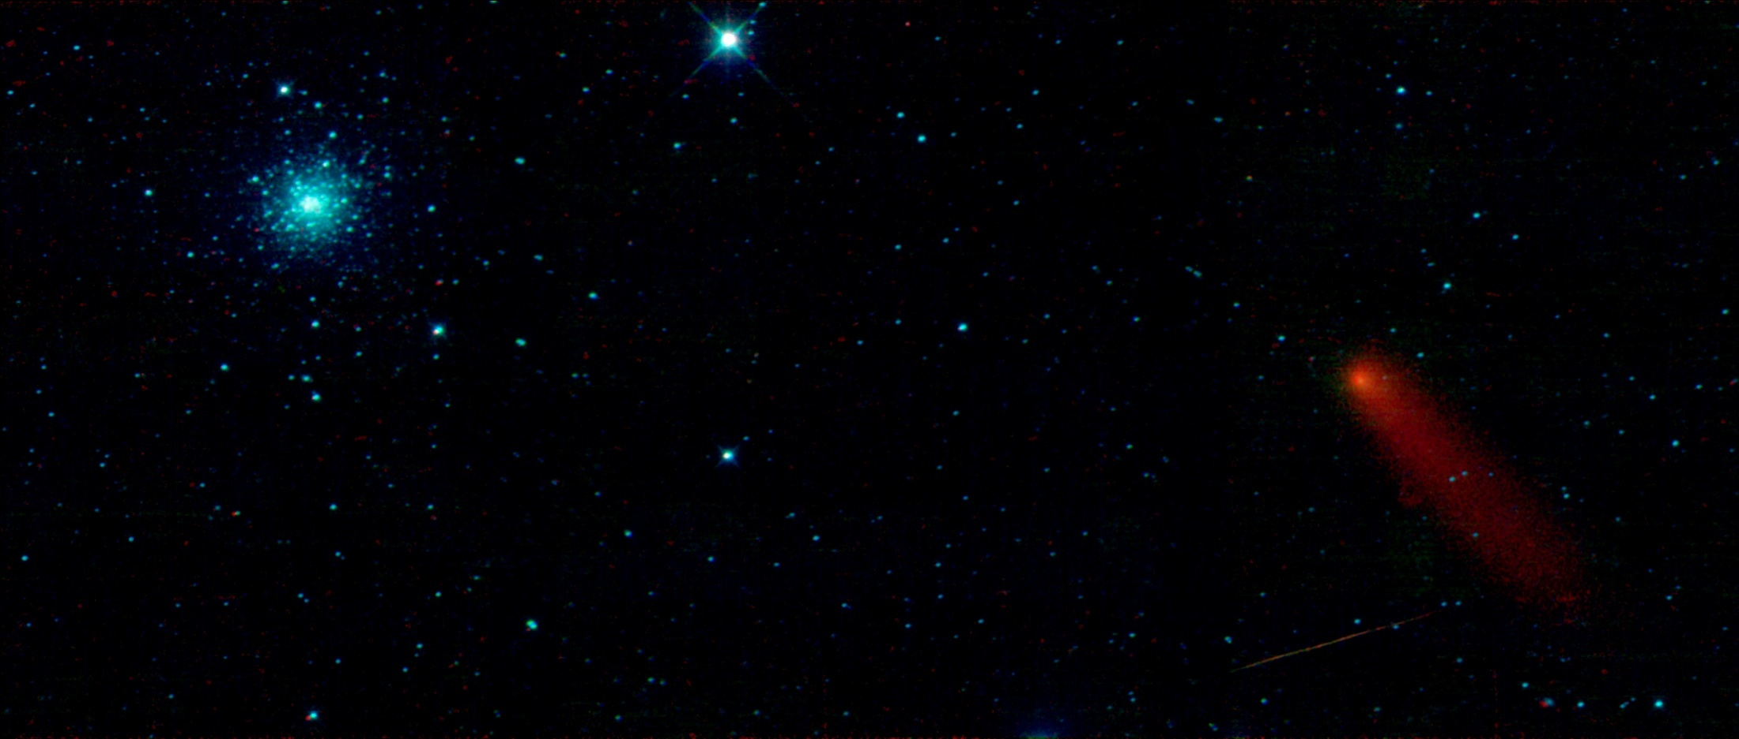
WISE Images – M3 & Comet Garradd

Slide 9
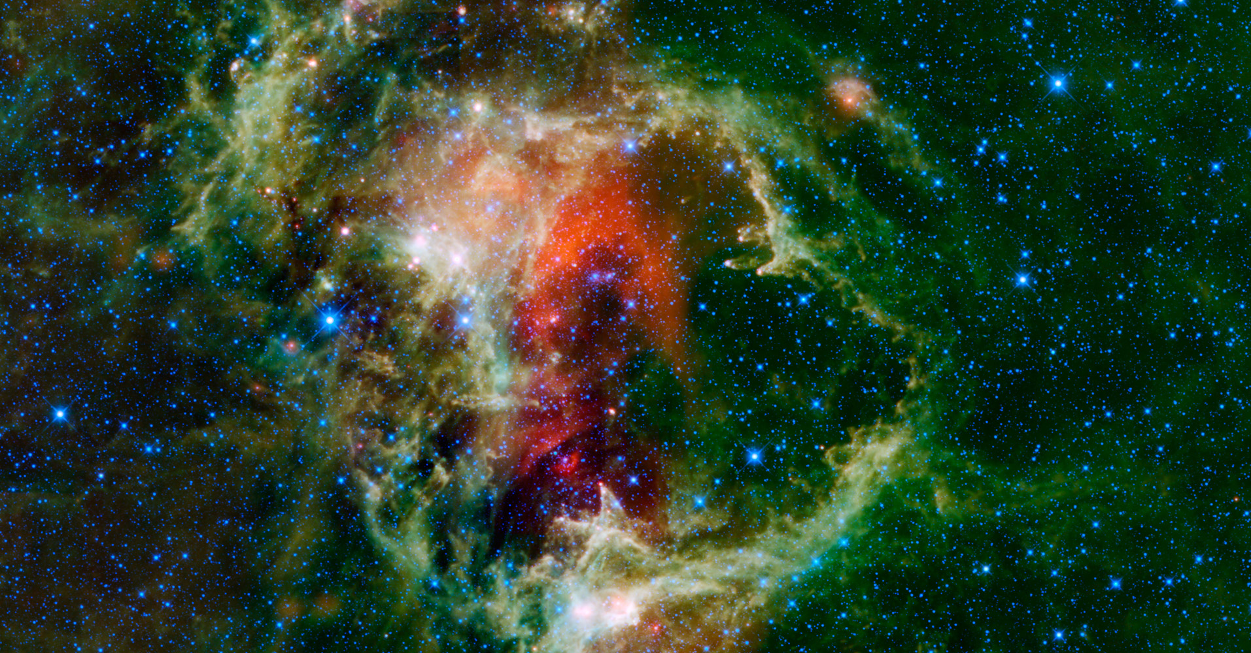
WISE Images – Soul Nebula

Slide 10
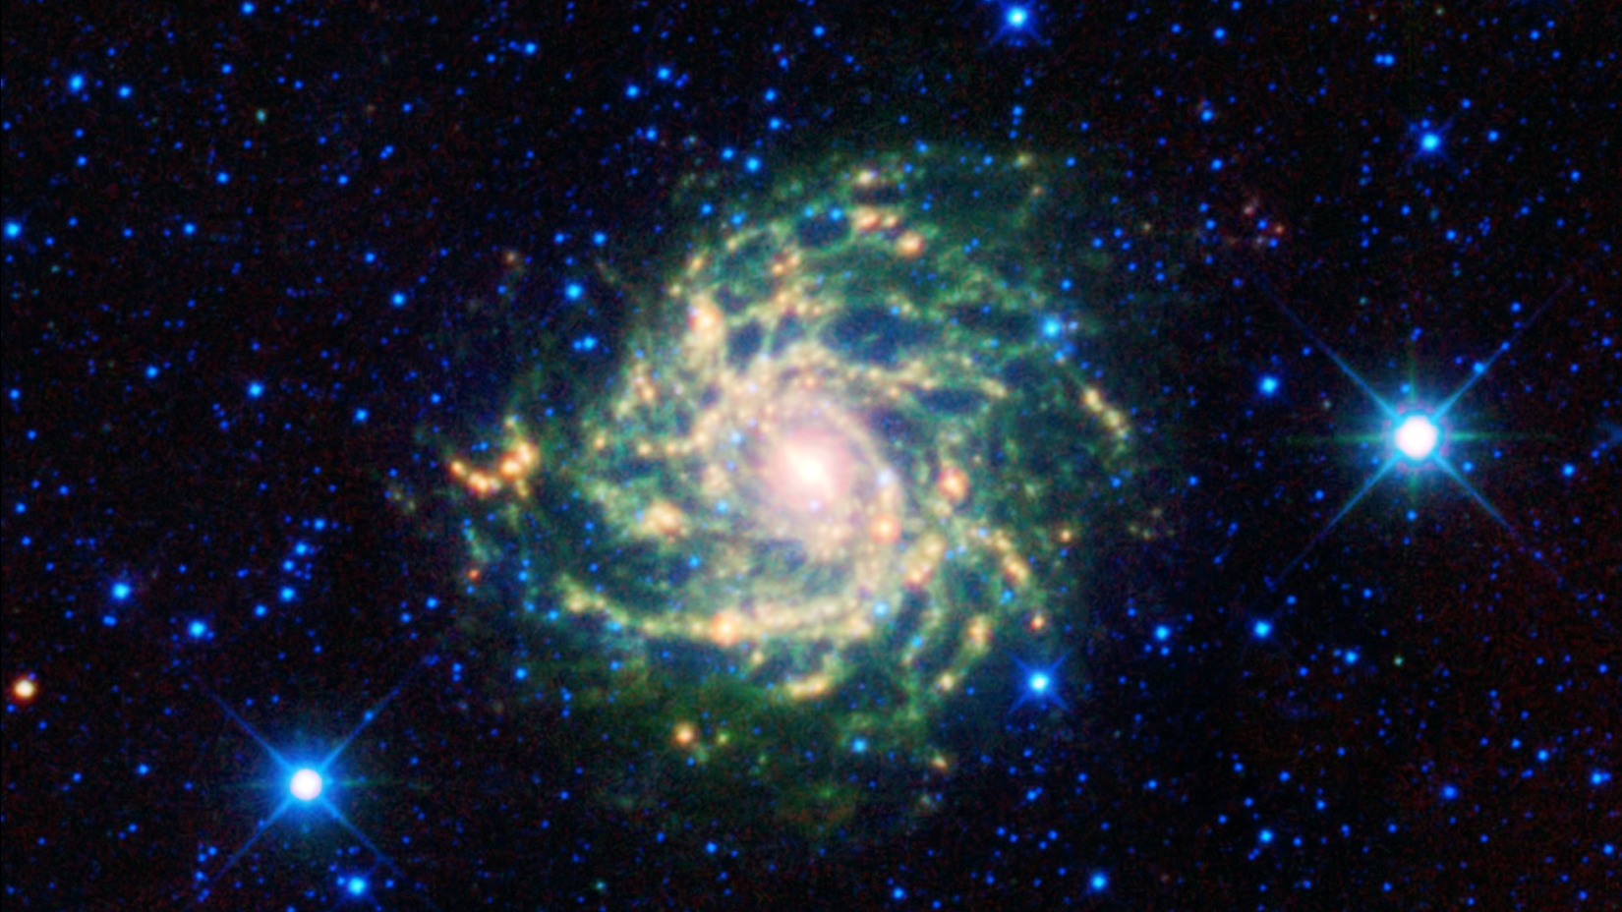
WISE Images – IC 342

Slide 11
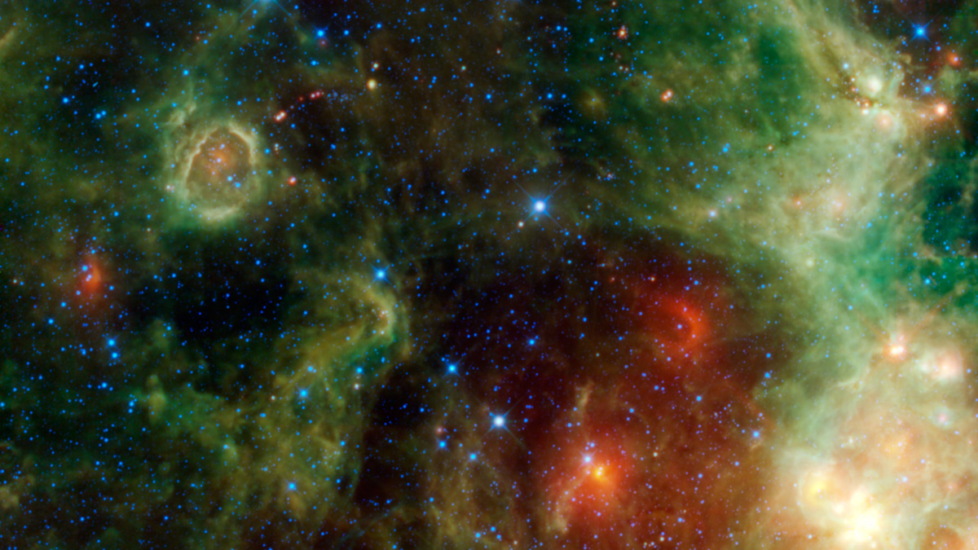
WISE Images – IC 1795

Slide 12
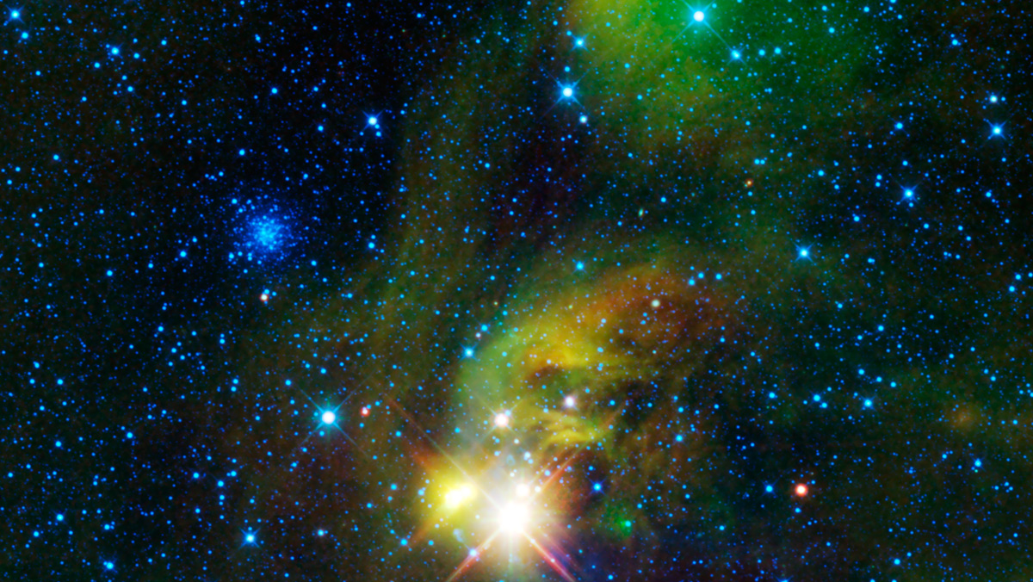
WISE Images – NGC 6723, NGC 6726, & IC 4812

Slide 13
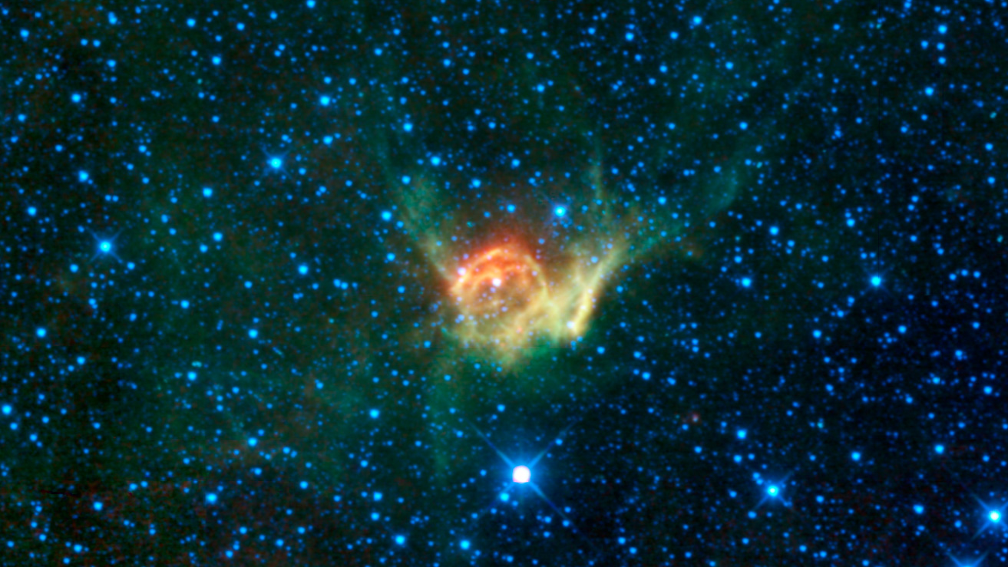
WISE Images – Thor’s Helmet

Slide 14
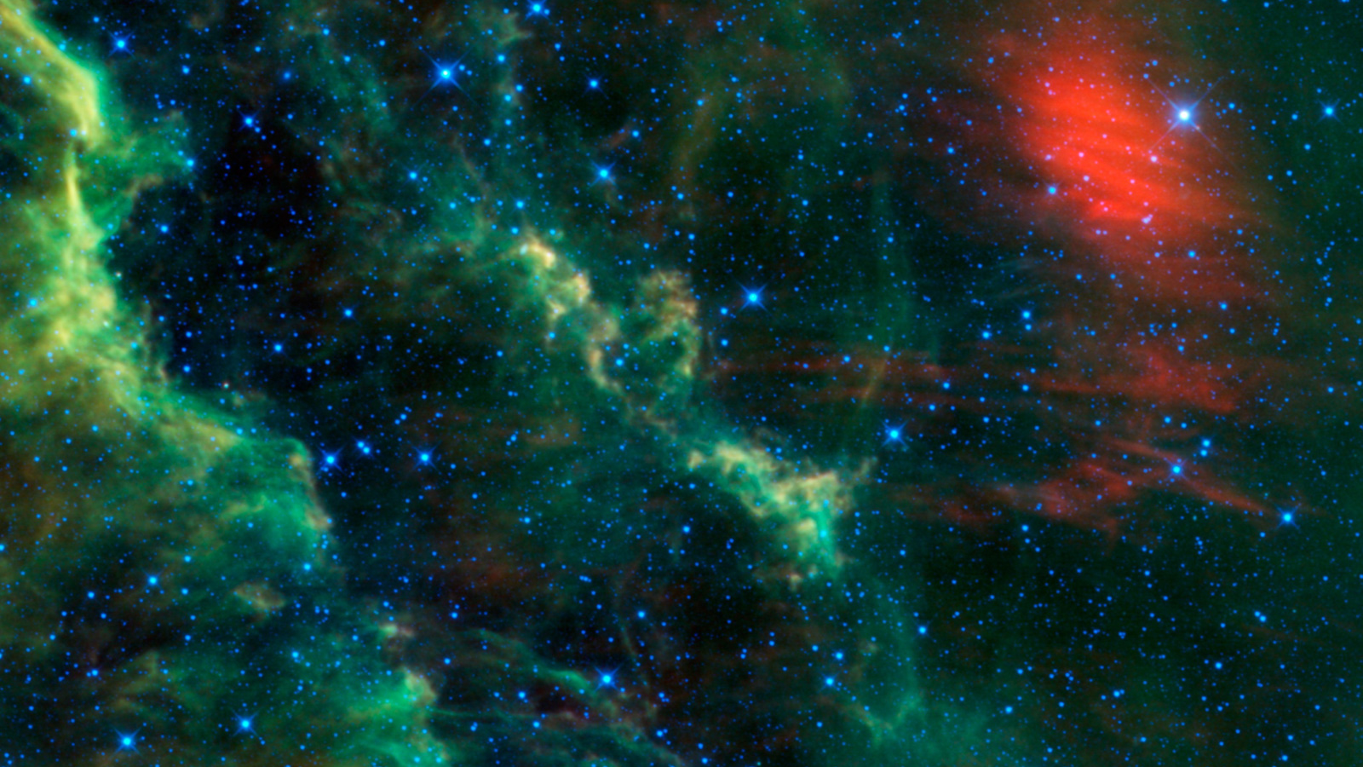
WISE Images – Menkhib and the California Nebula

Slide 15
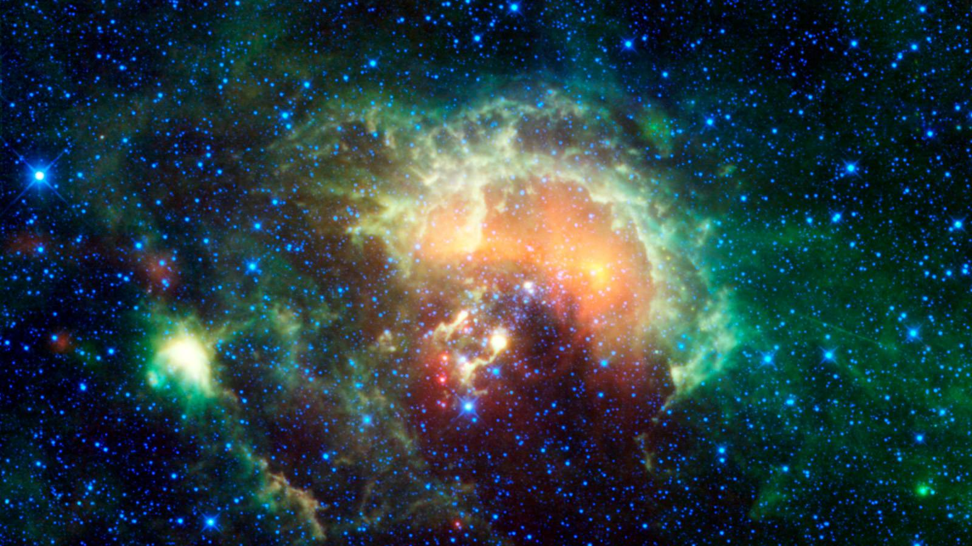
WISE Images – Tadpole Nebula

Slide 16
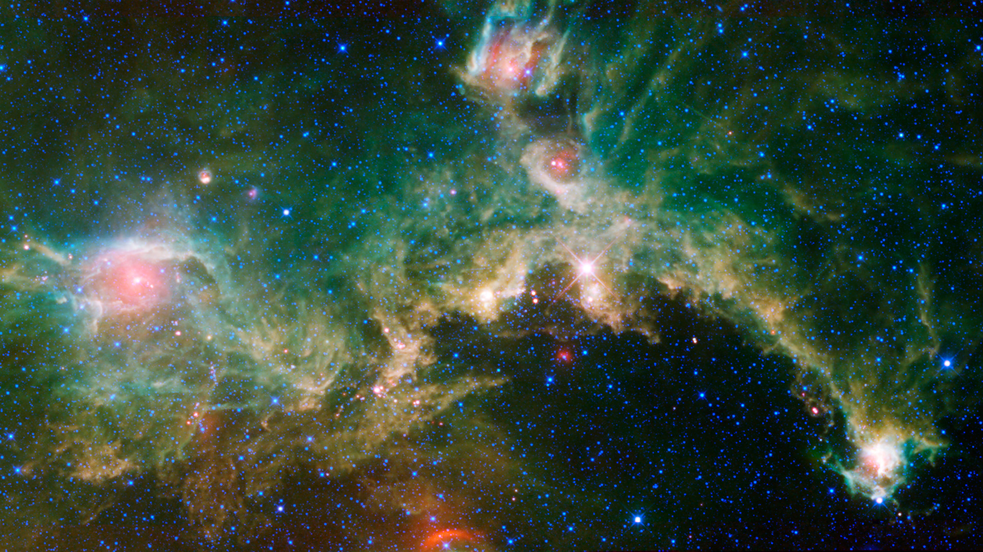
WISE Images – Tadpole Nebula
WISE Images – Seagull Nebula

Slide 17
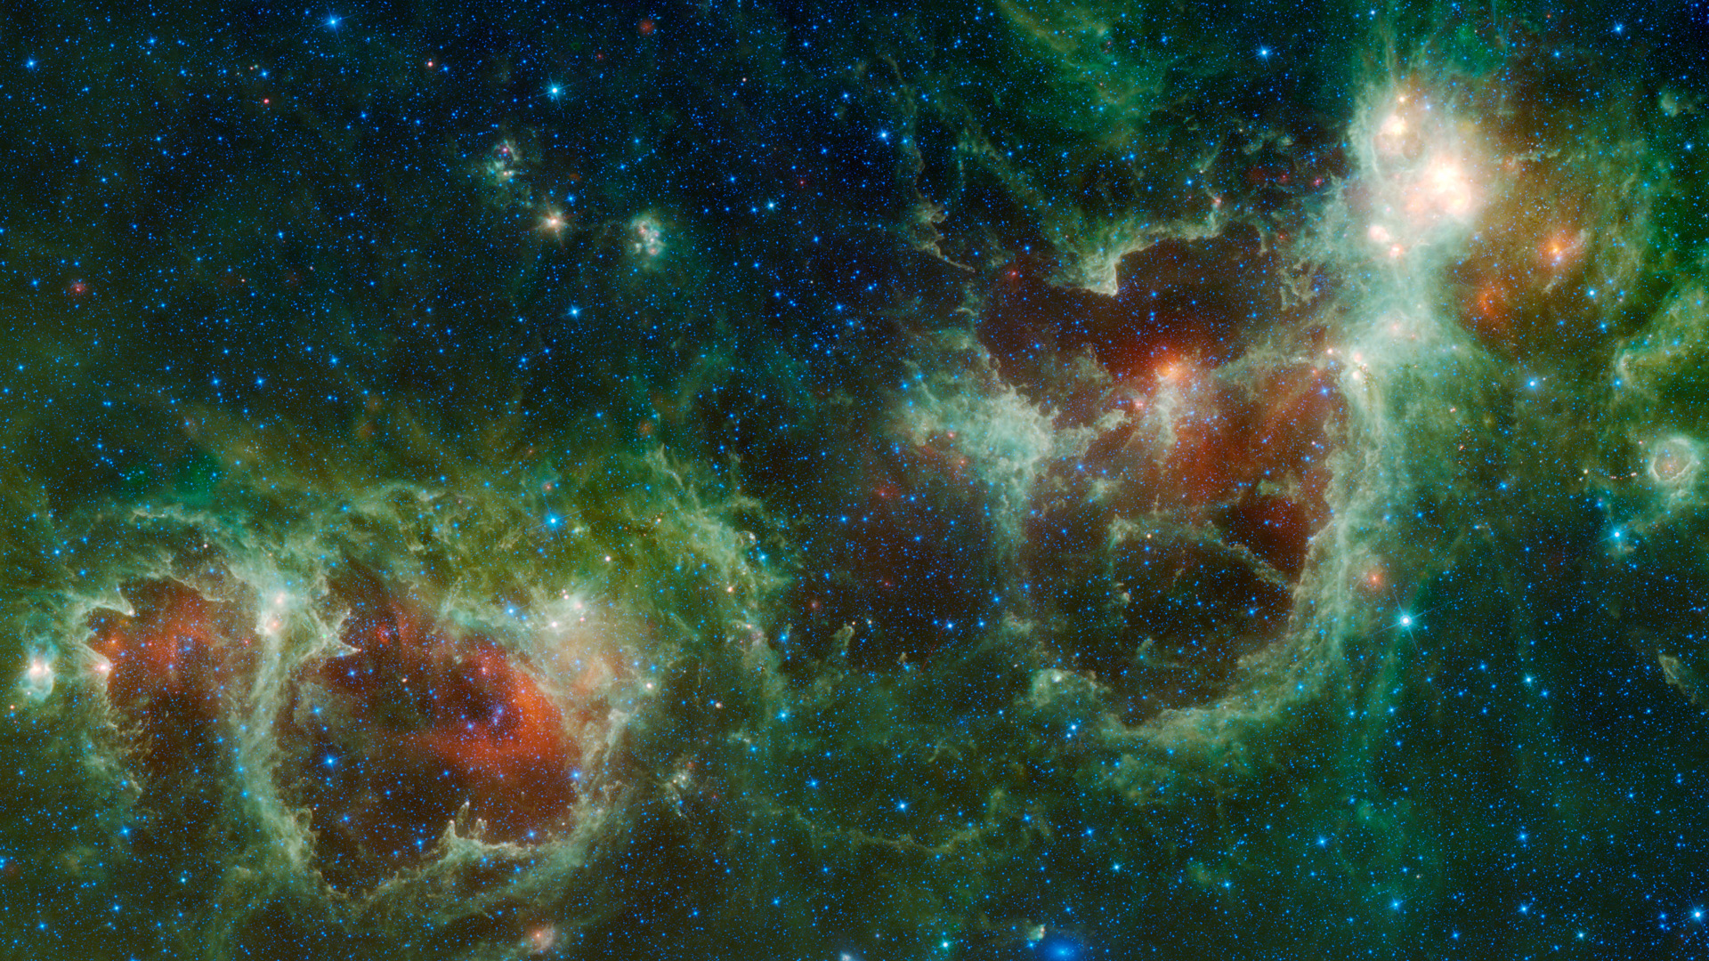
WISE Images –
WISE Images – Heart and Soul Nebula

Slide 18
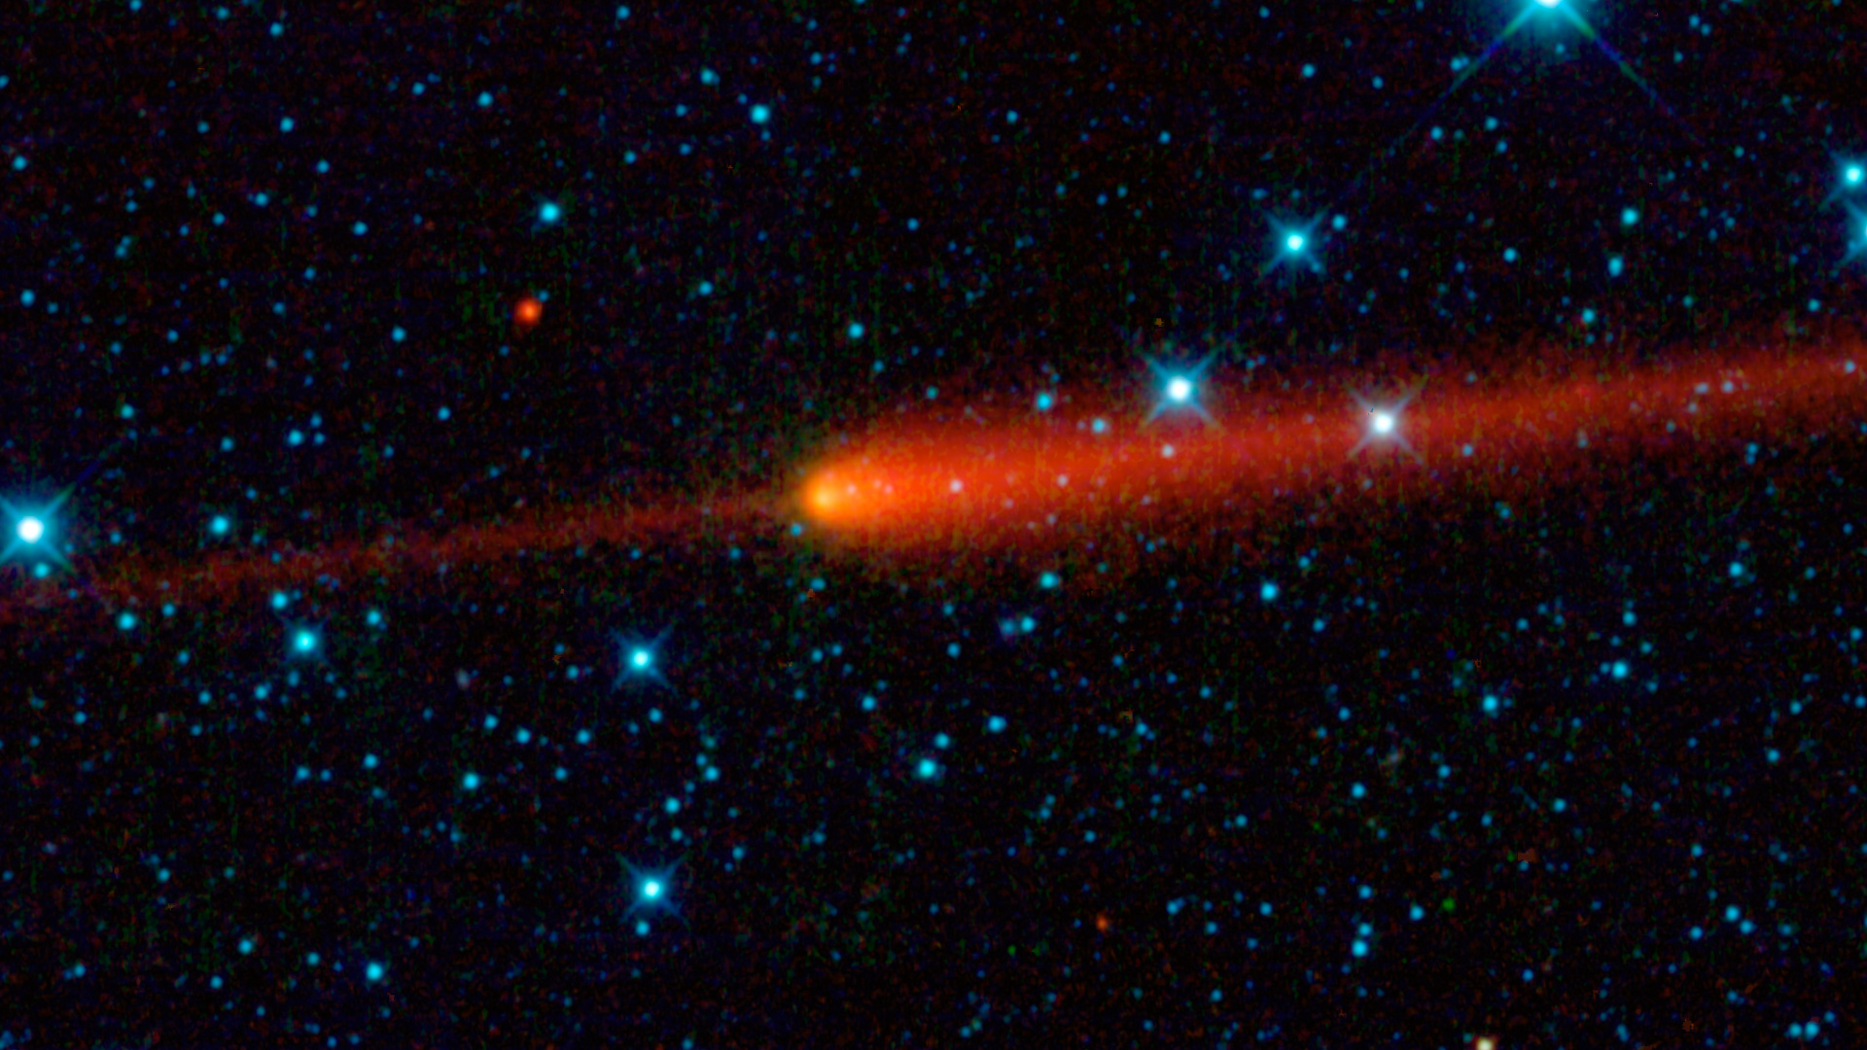
WISE Images – Comet 65P/Gunn

Slide 19
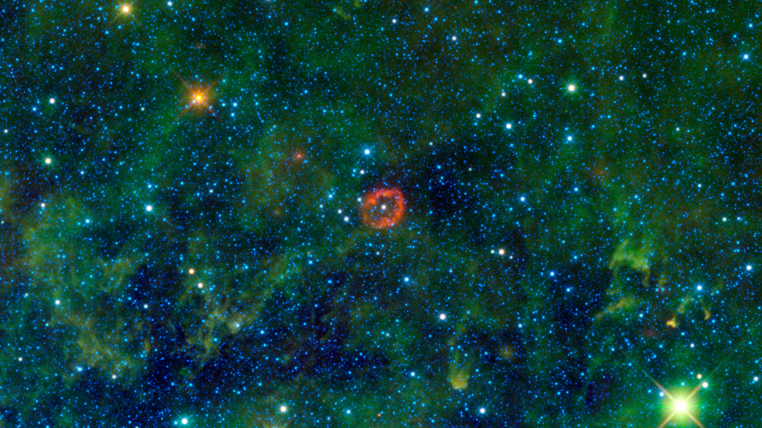
WISE Images – V385 Carinae

Slide 20
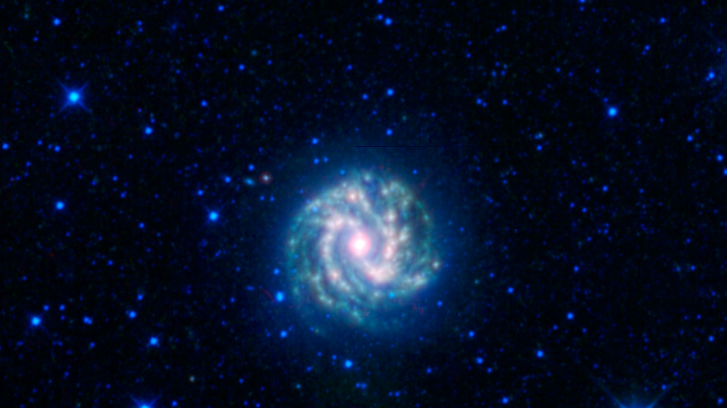
WISE Images – Messier 83

Slide 21
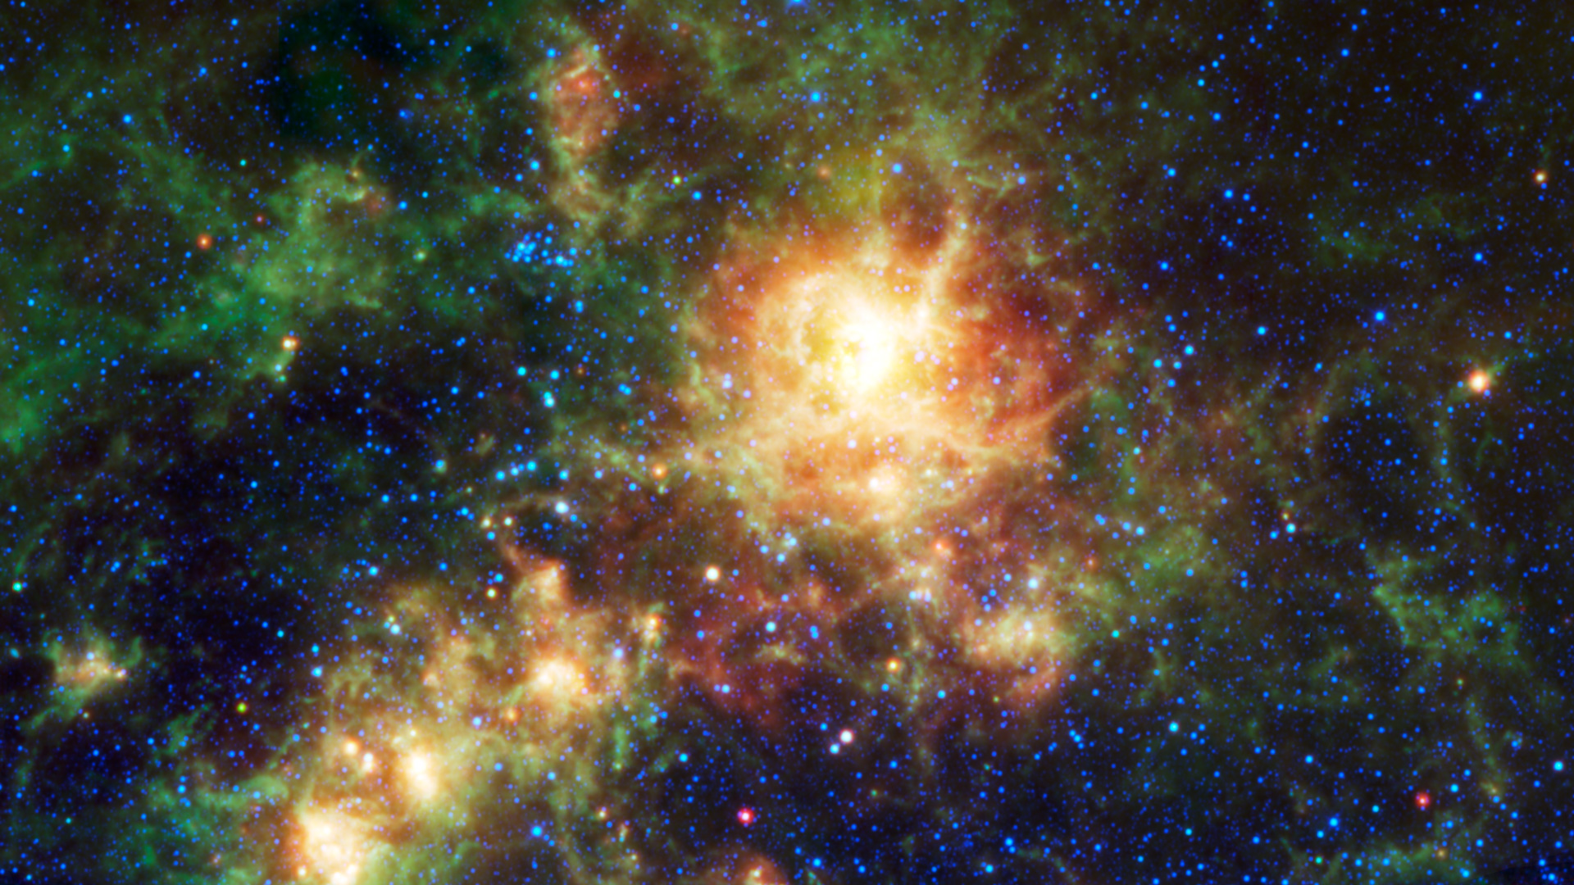
WISE Images – Tarantula Nebula

Slide 22
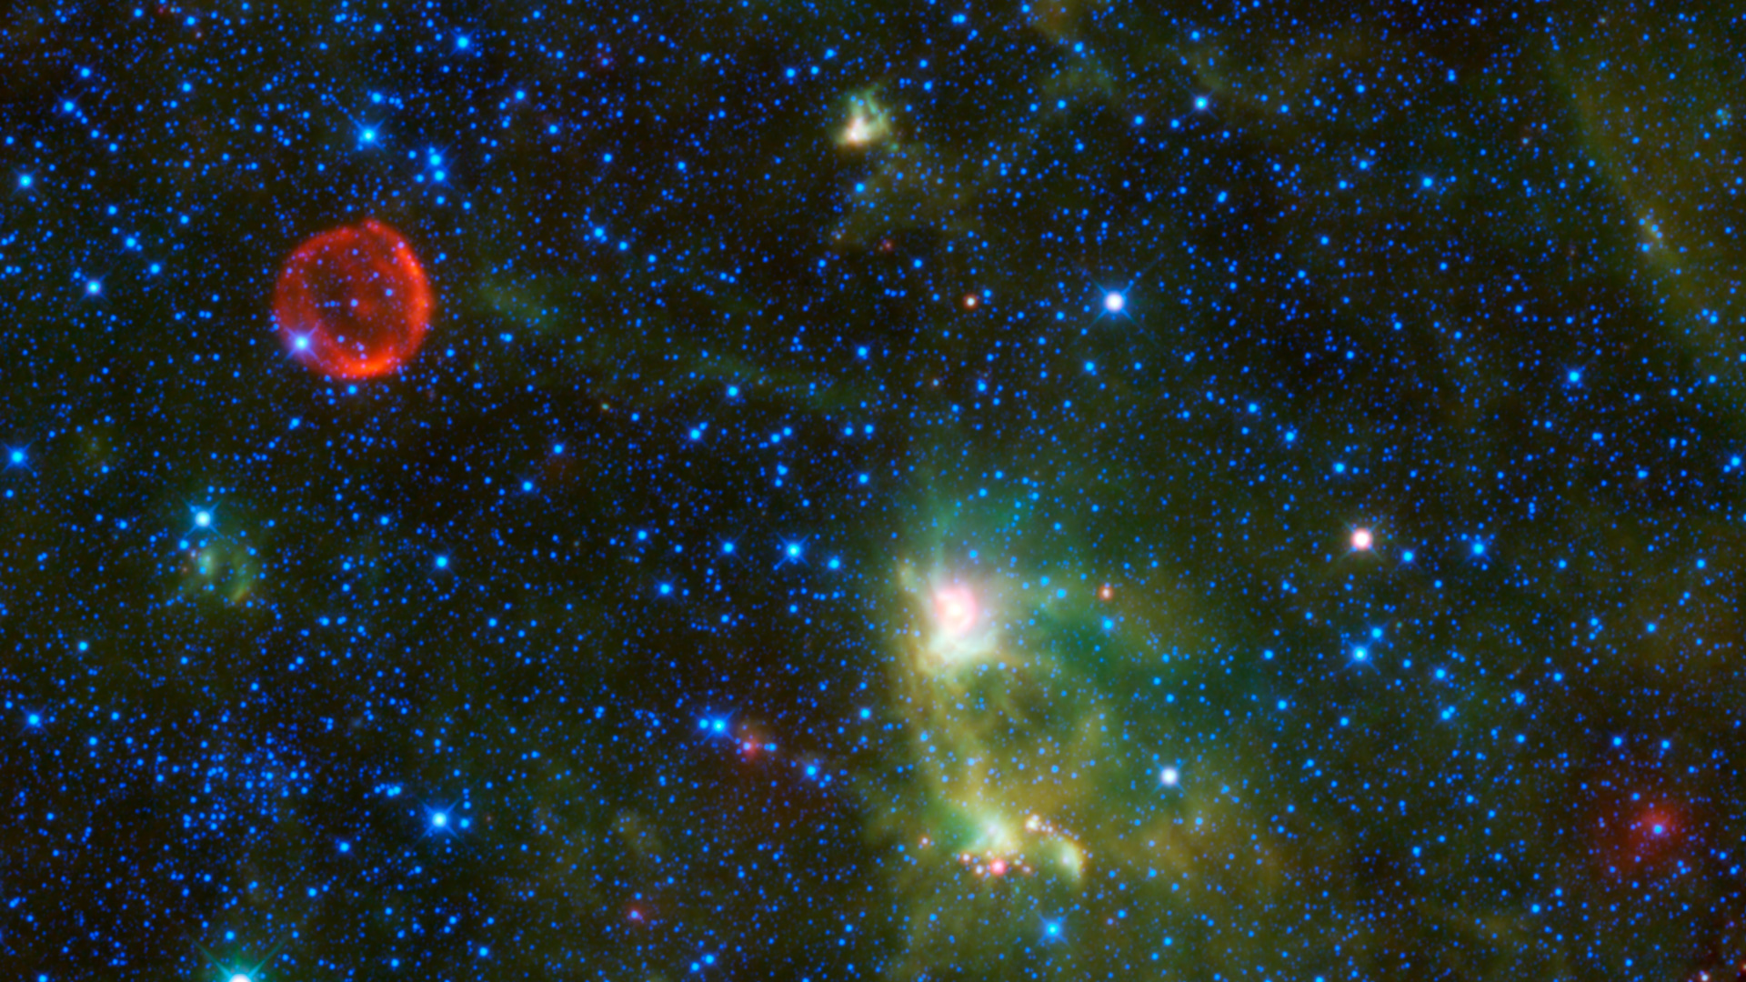
WISE Images – Tycho Supernova Remnant

Slide 23
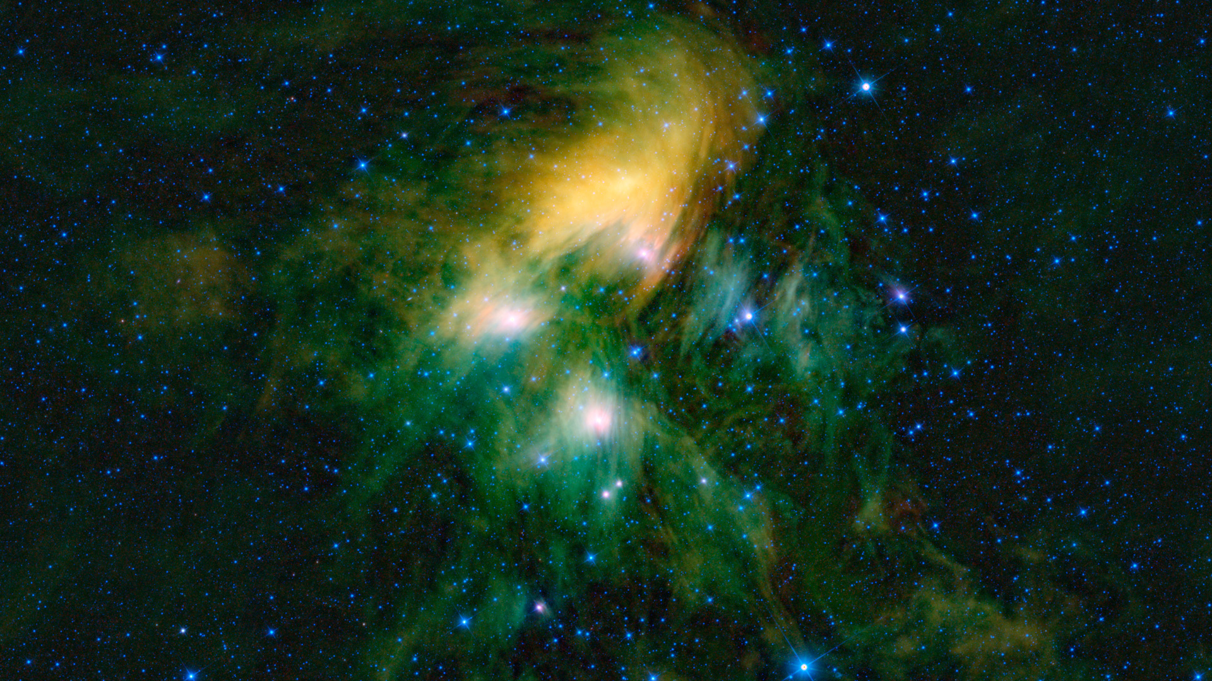
WISE Images – Pleiades

Slide 24
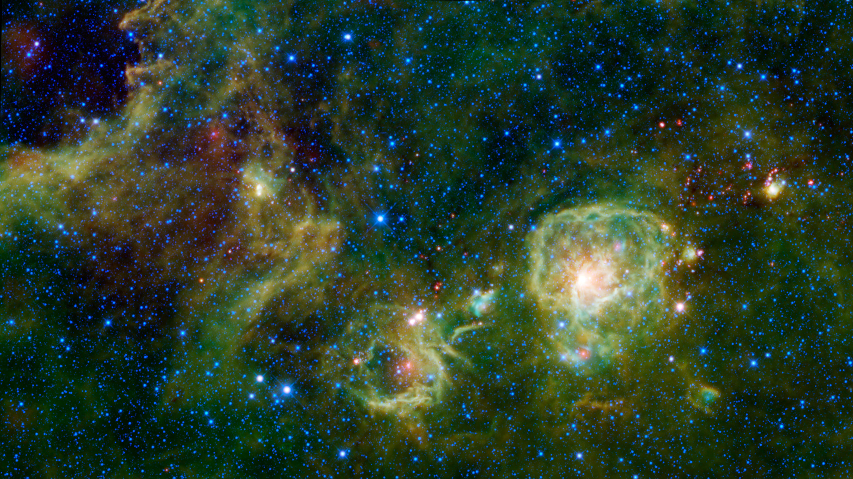
WISE Images – Vela A

Slide 25
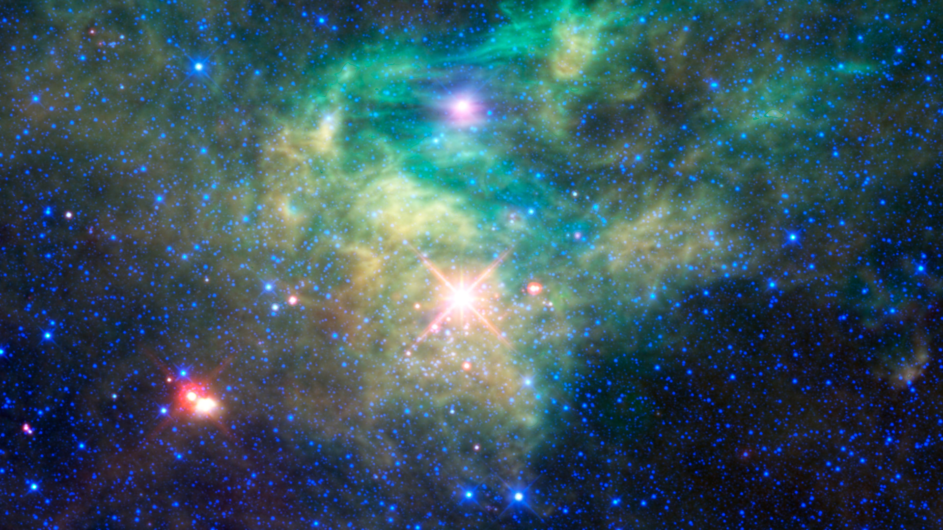
WISE Images – AFGL 490

Slide 26
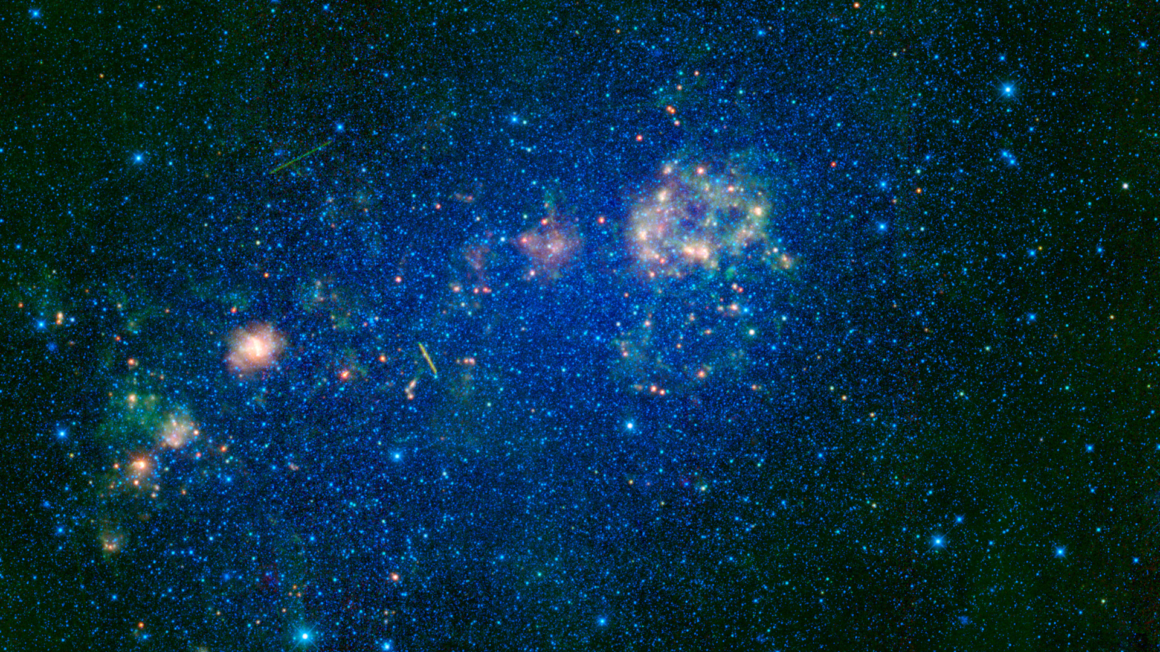
WISE Images – Small Magellanic Cloud

Slide 27
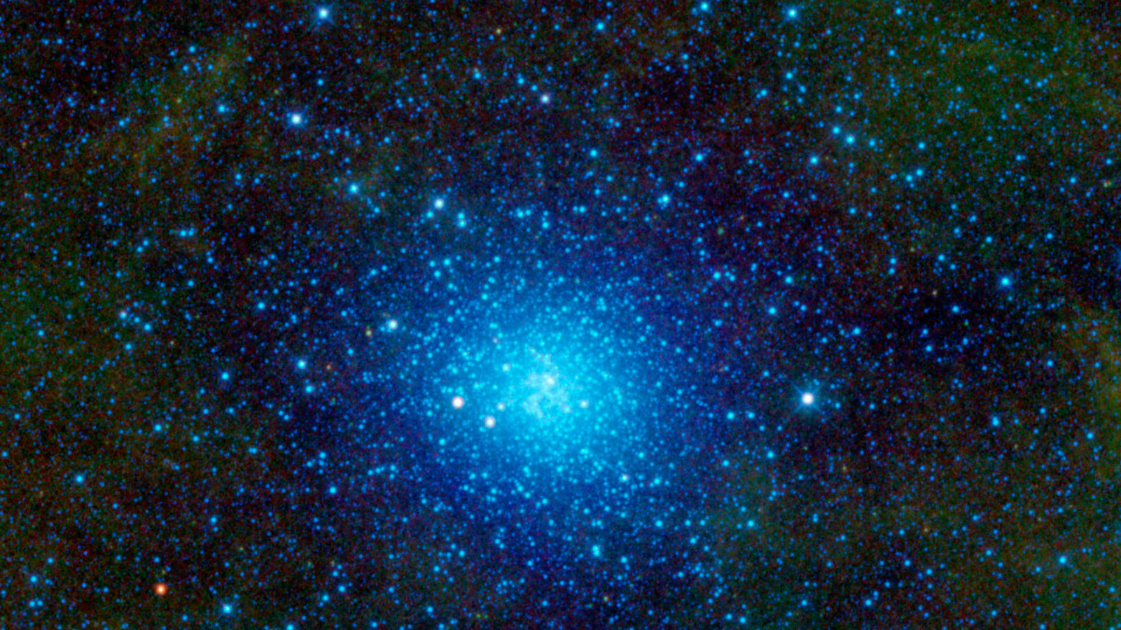
WISE Images – Omega Centauri

Slide 28
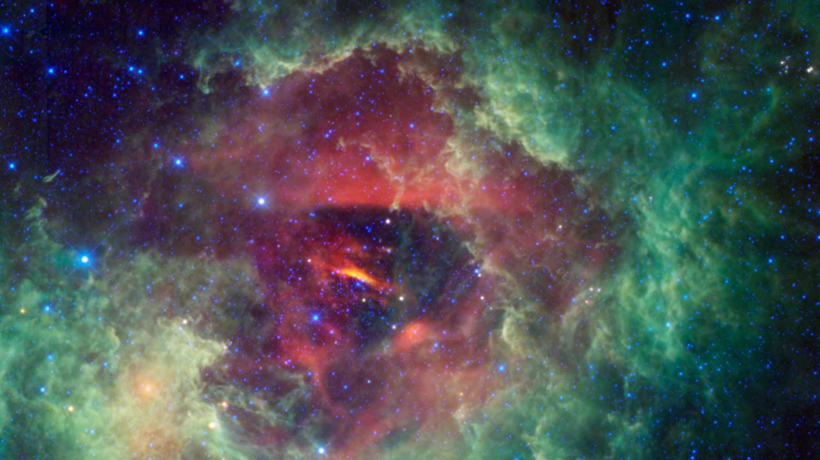
WISE Images – Rosette Nebula

Slide 29
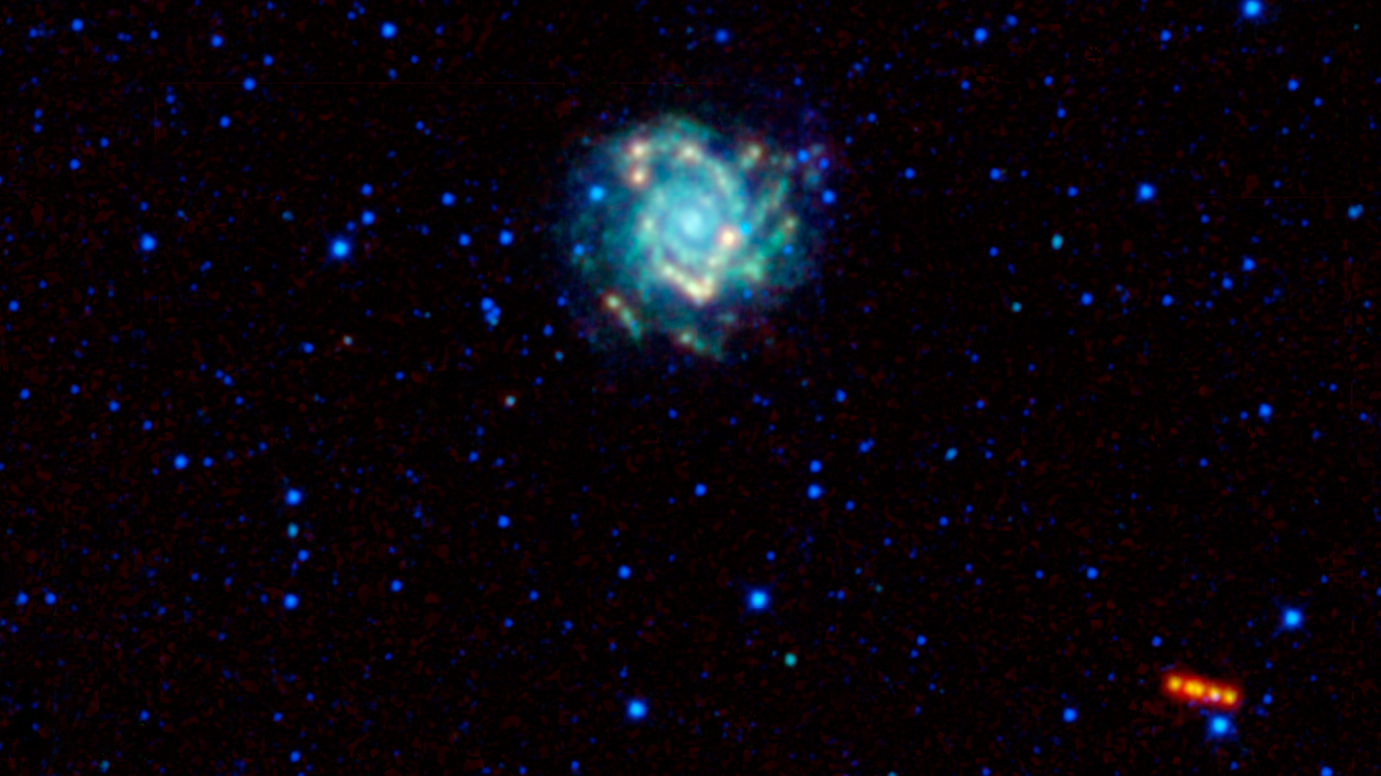
WISE Images – M74

Slide 30
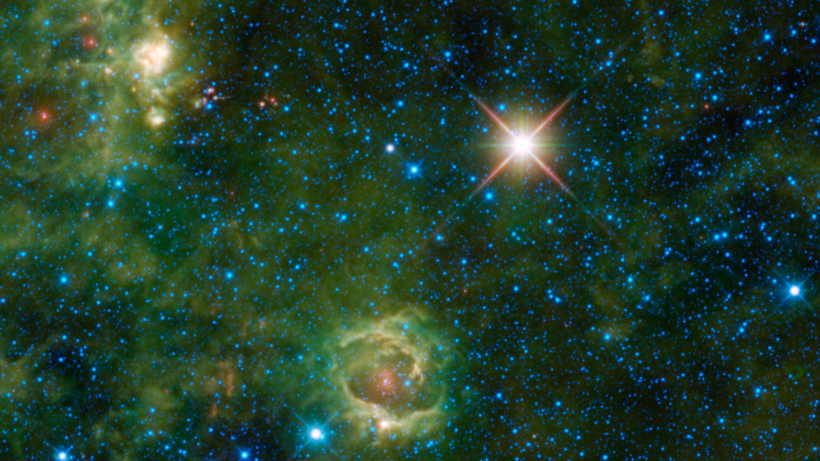
WISE Images – LBN 114.55+00.22

Slide 31
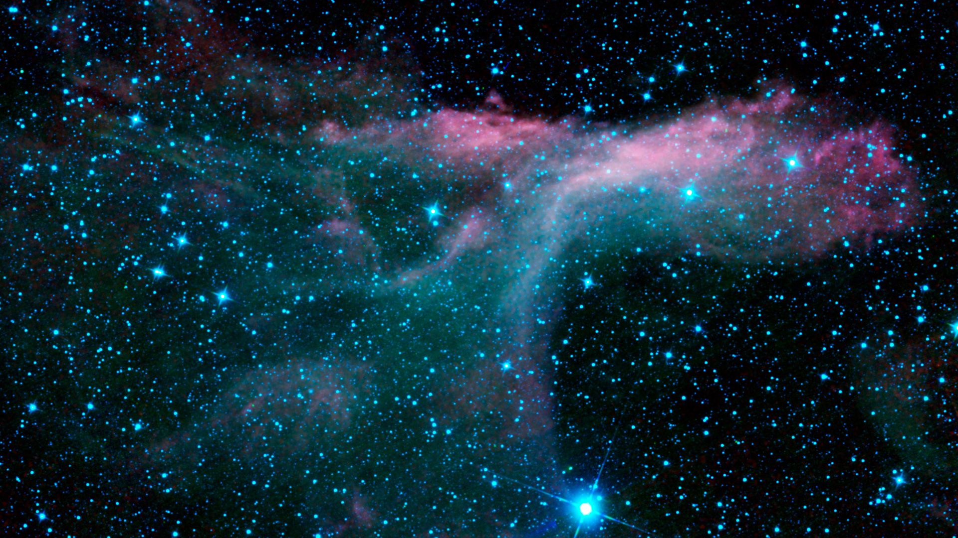
WISE Images – Pi Scorpii

Slide 32
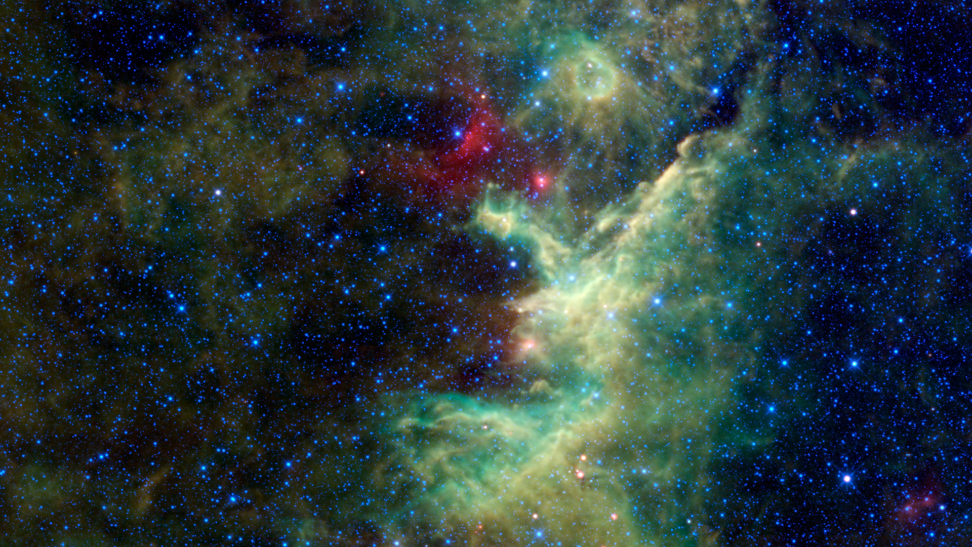
WISE Images – IRAS 22298+6505

Slide 33
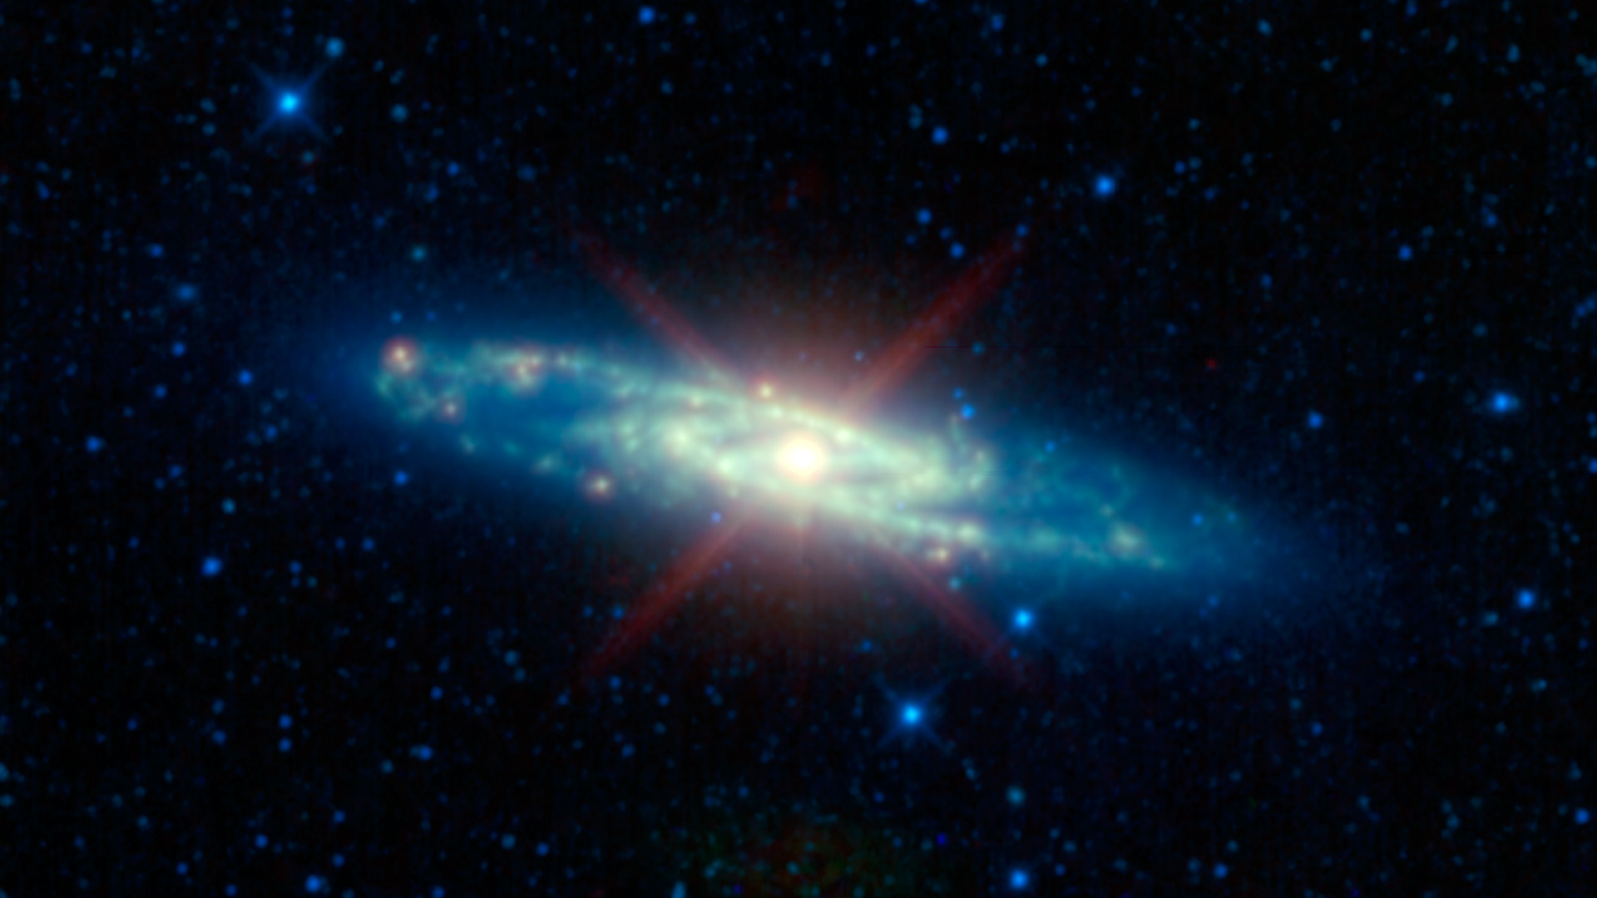
WISE Images – Sculptor Galaxy

Slide 34
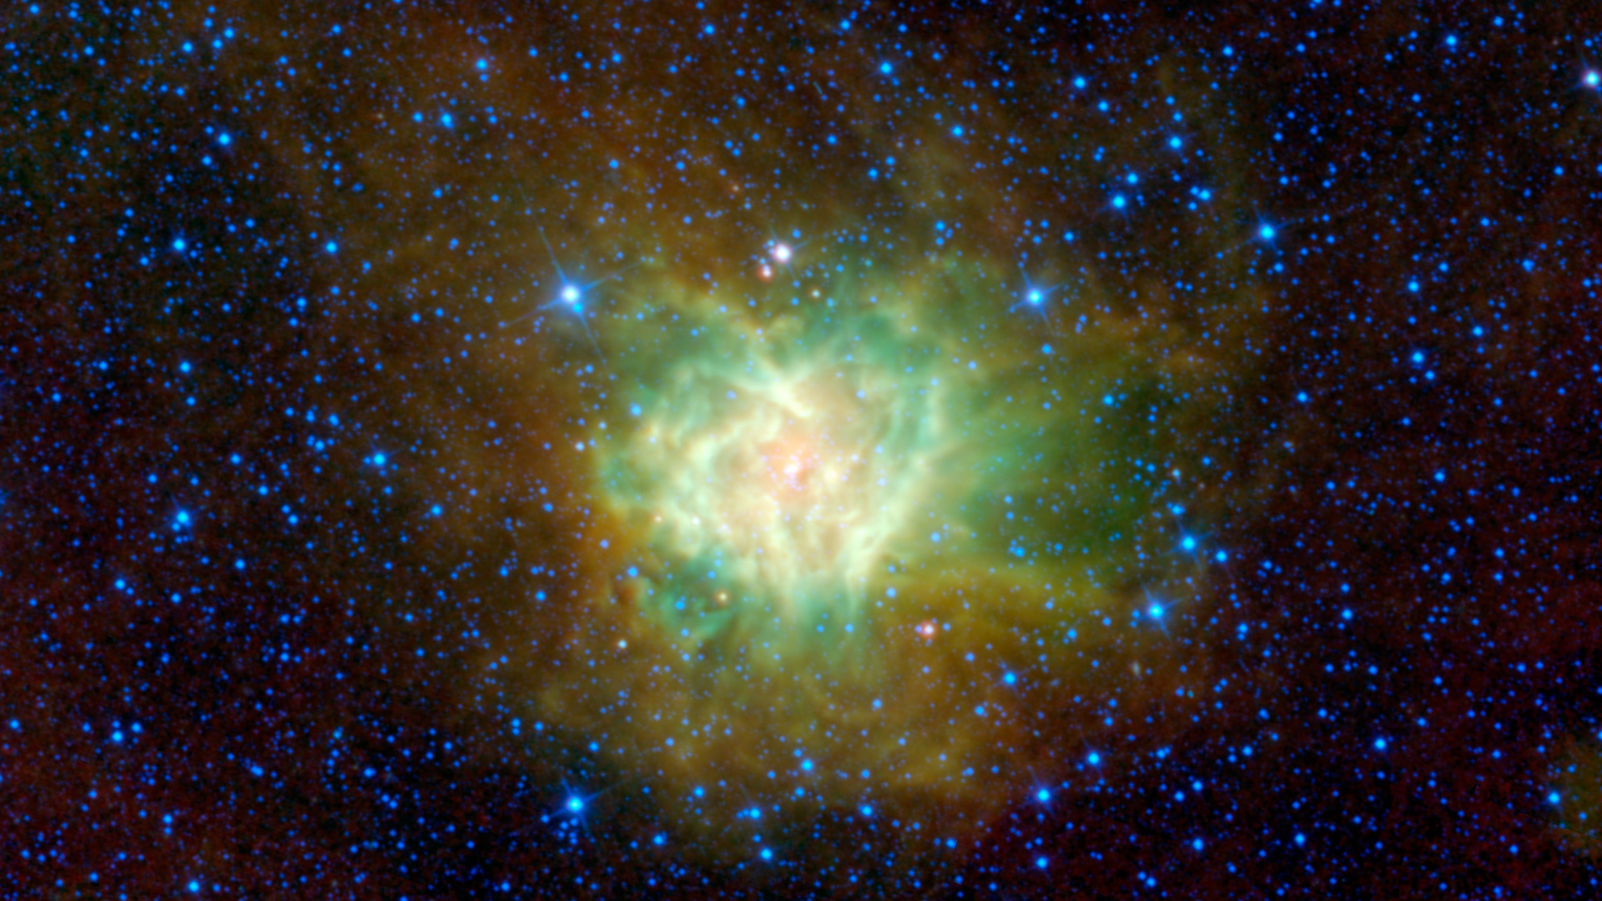
WISE Images – Cocoon Nebula

Slide 35
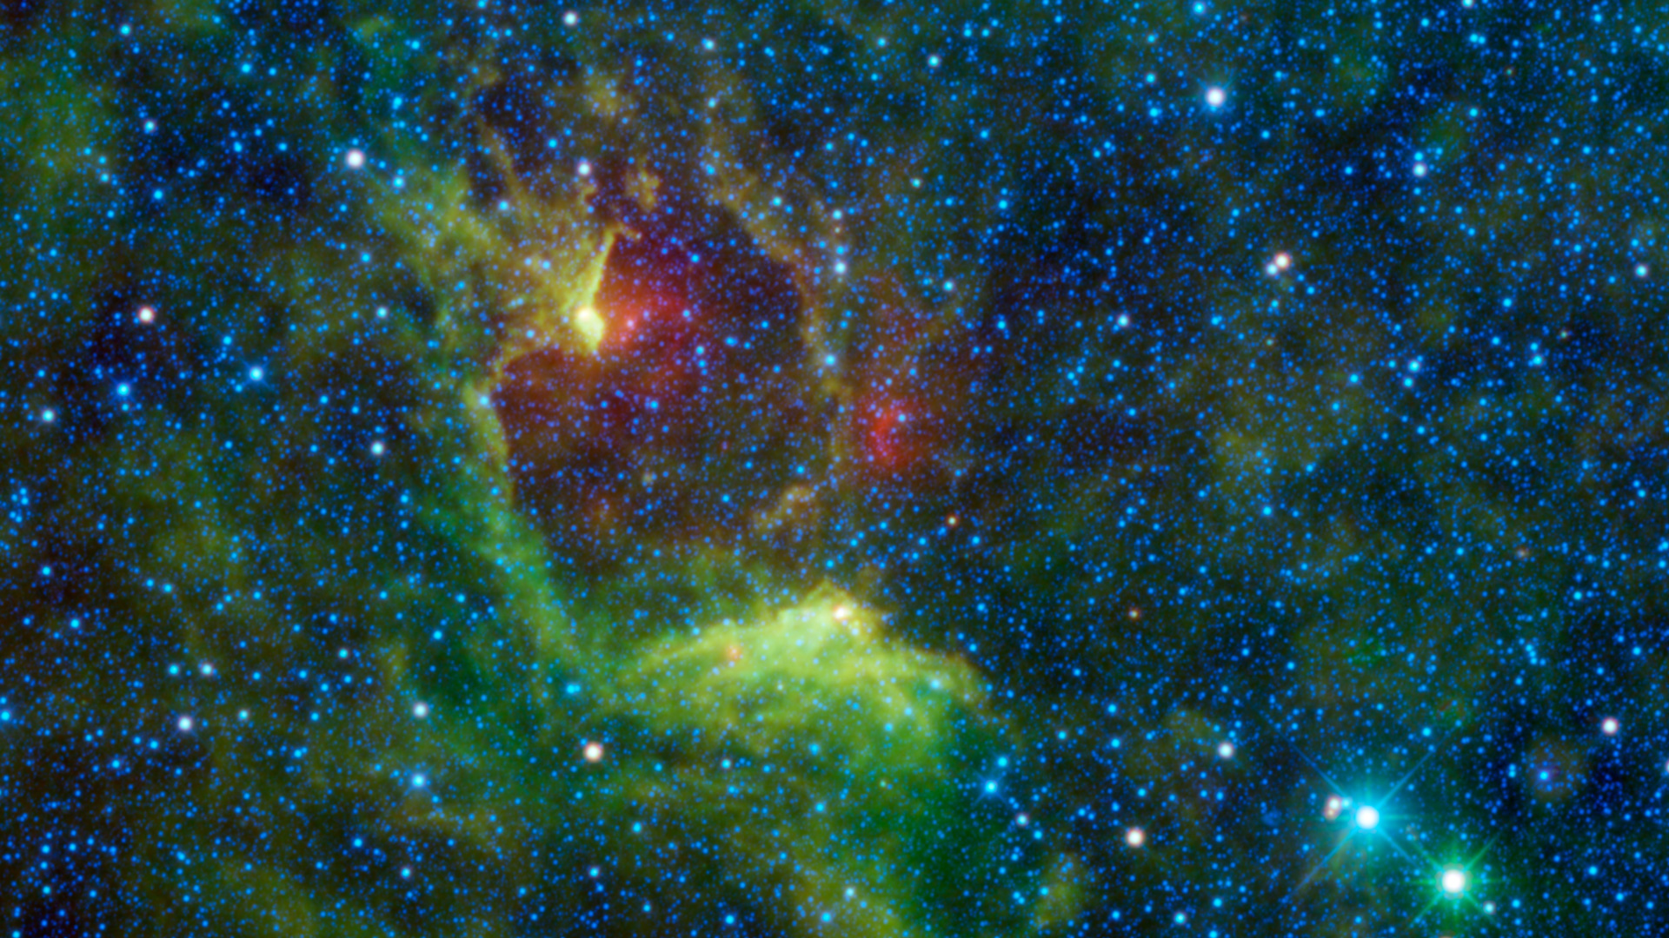
WISE Images – IRAS 12116-6001

Slide 36
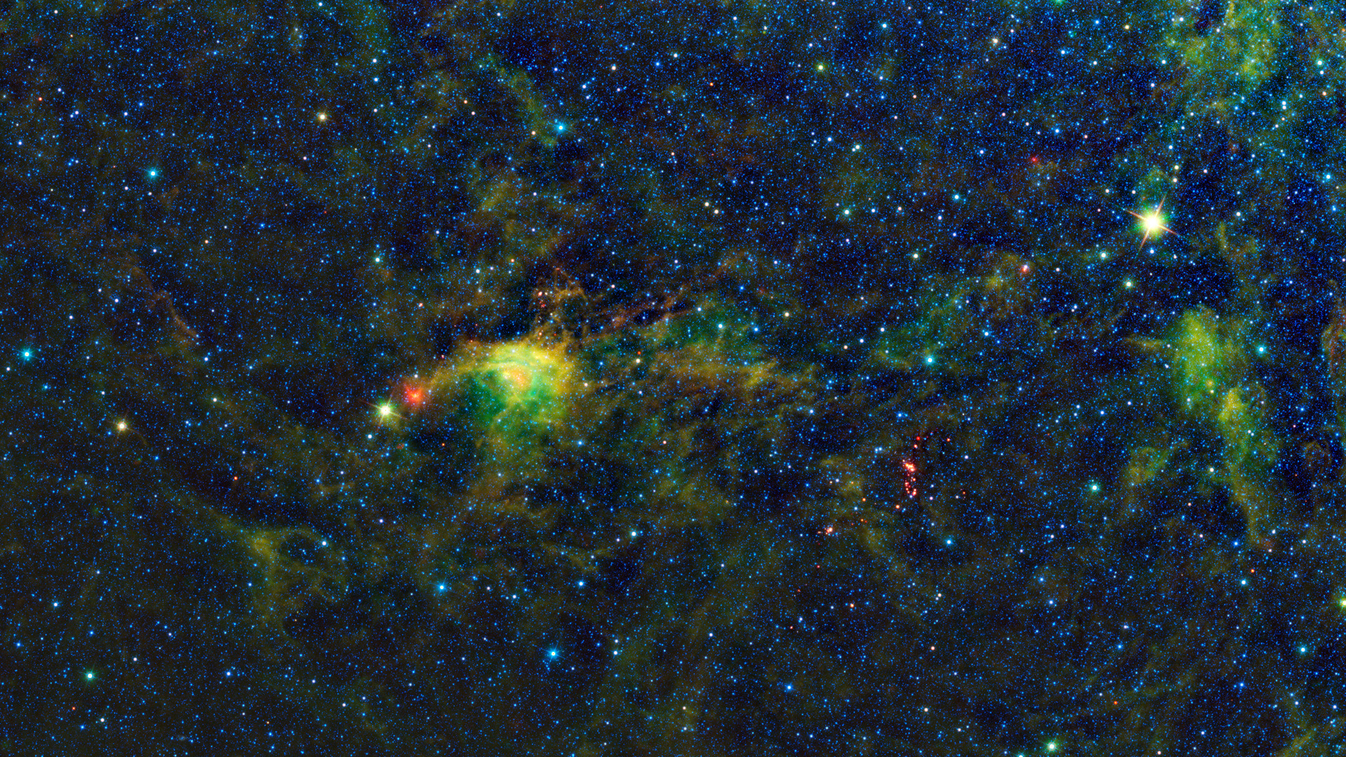
WISE Images – Circinus Molecular Cloud

Slide 37
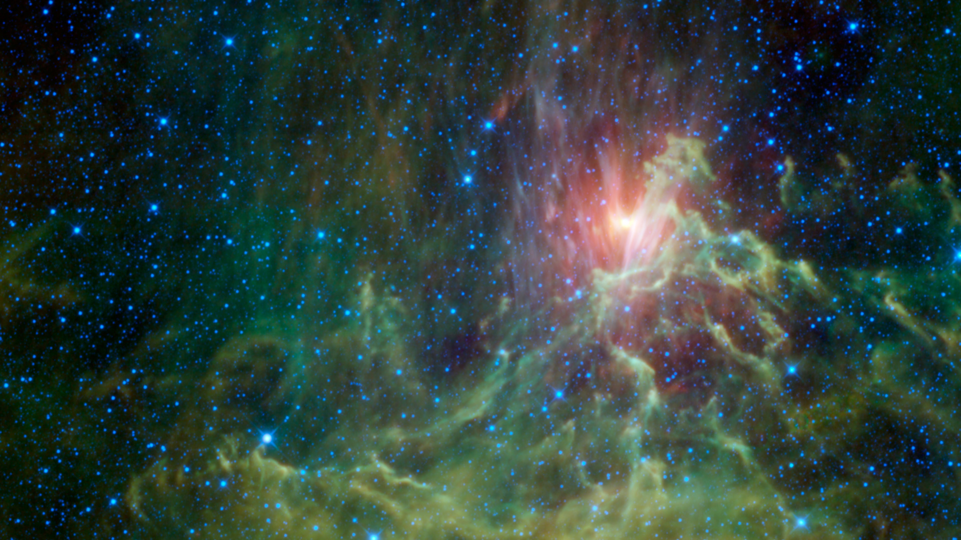
WISE Images – IC 405

Slide 38
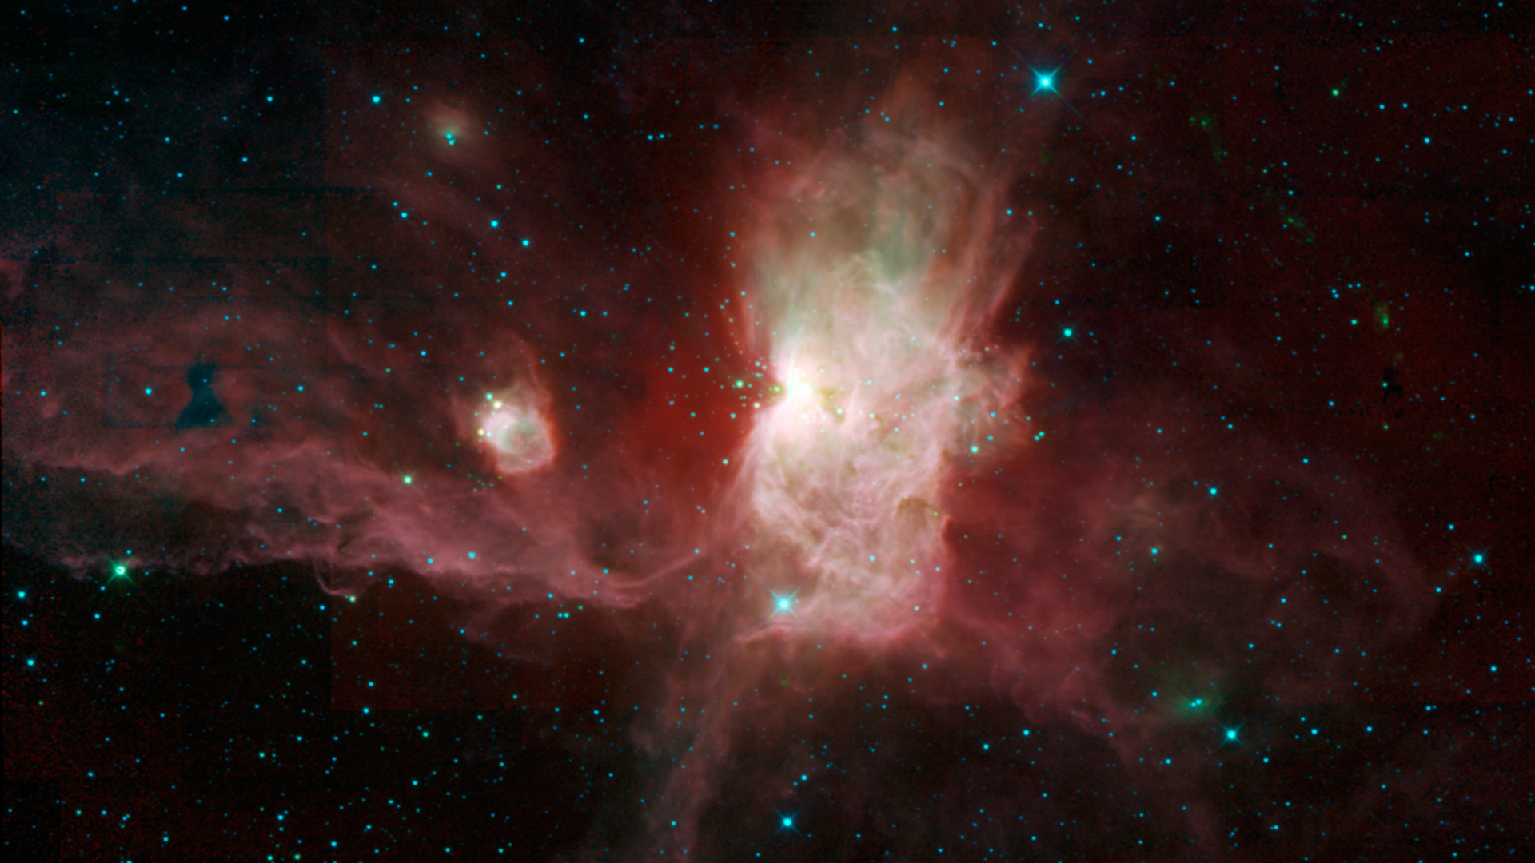
WISE Images – Flame Nebula

Slide 39
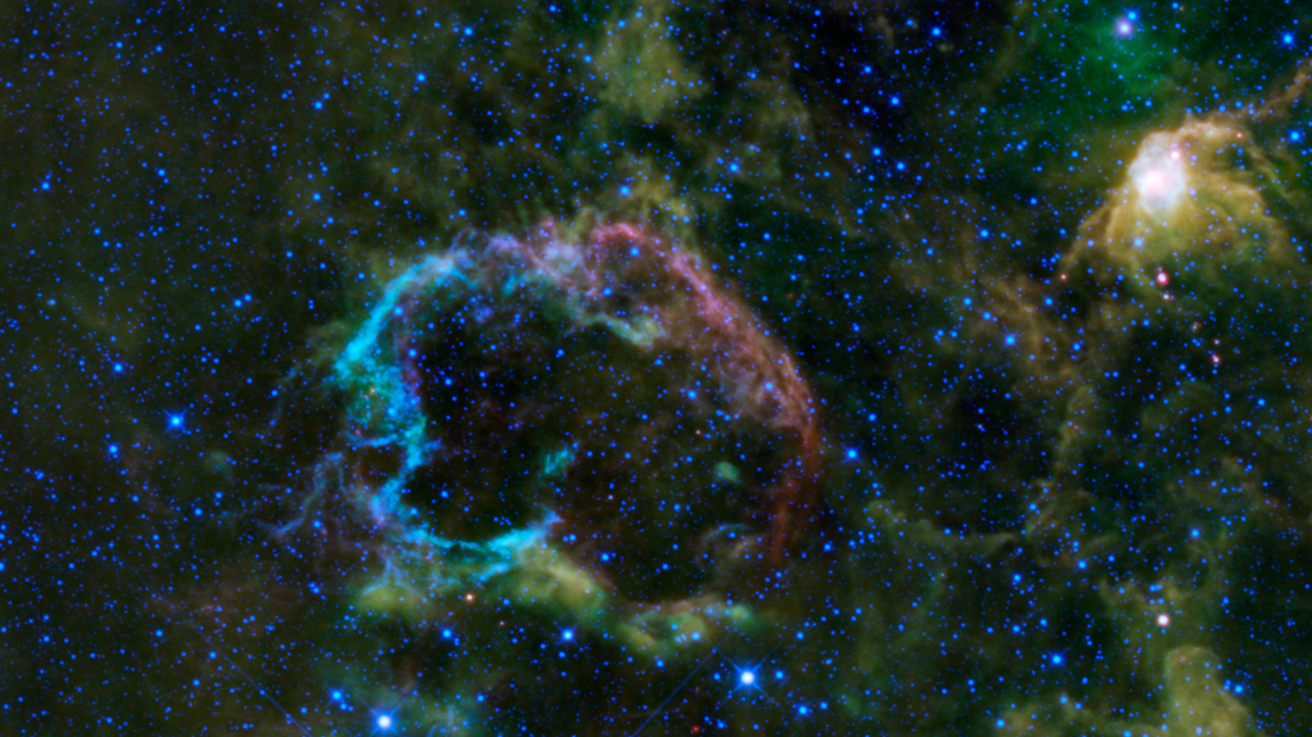
WISE Images – Jellyfish Nebula

Slide 40
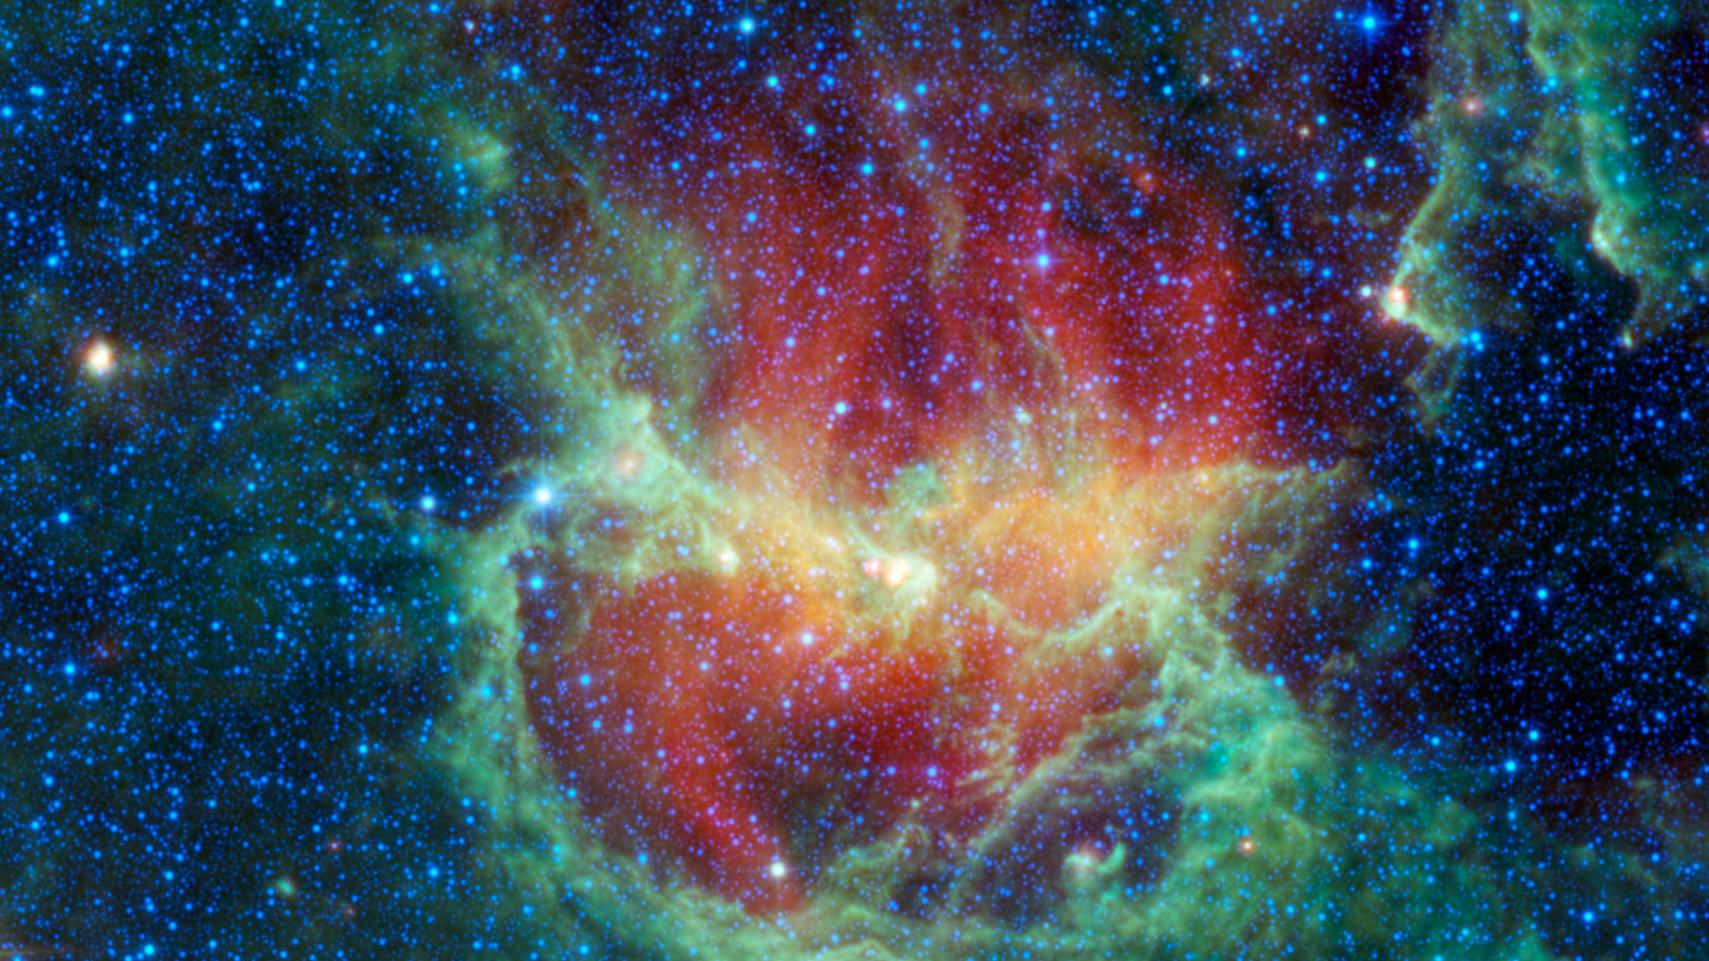
WISE Images – Lambda Centauri Nebula

Slide 41
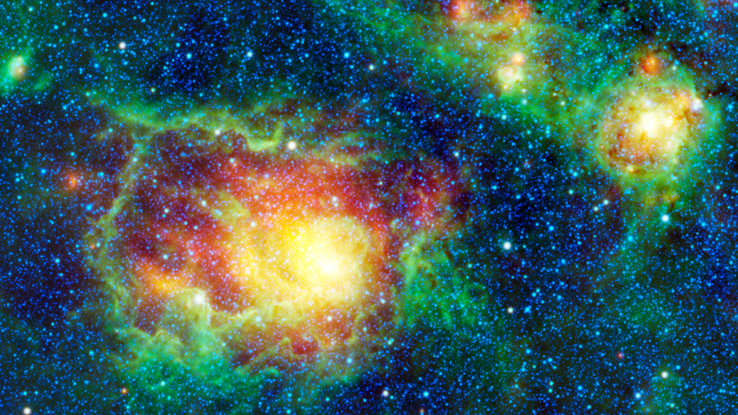
WISE Images – Lagoon Nebula

Slide 42
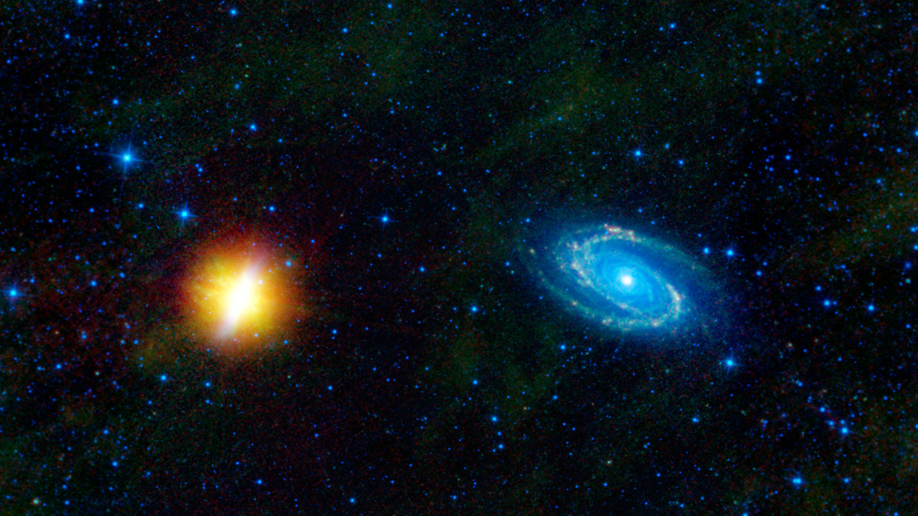
WISE Images – M81 & M82

Slide 43
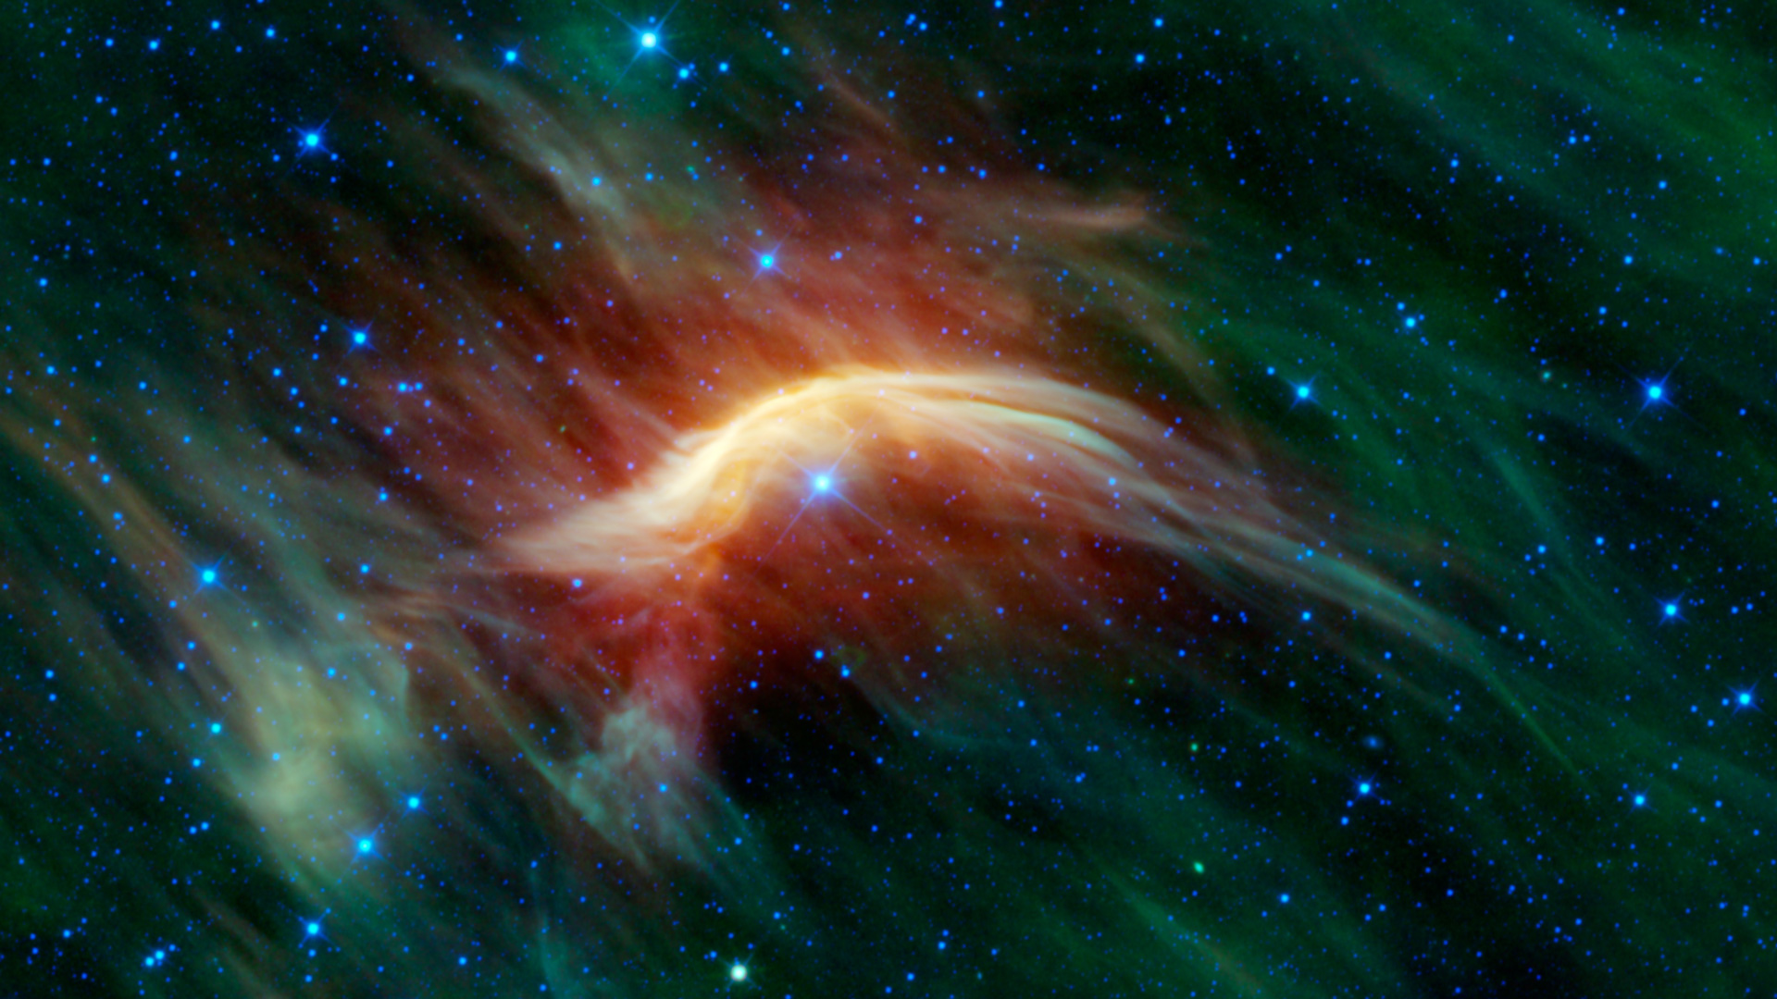
WISE Images – Zeta Ophiuchi

Slide 44
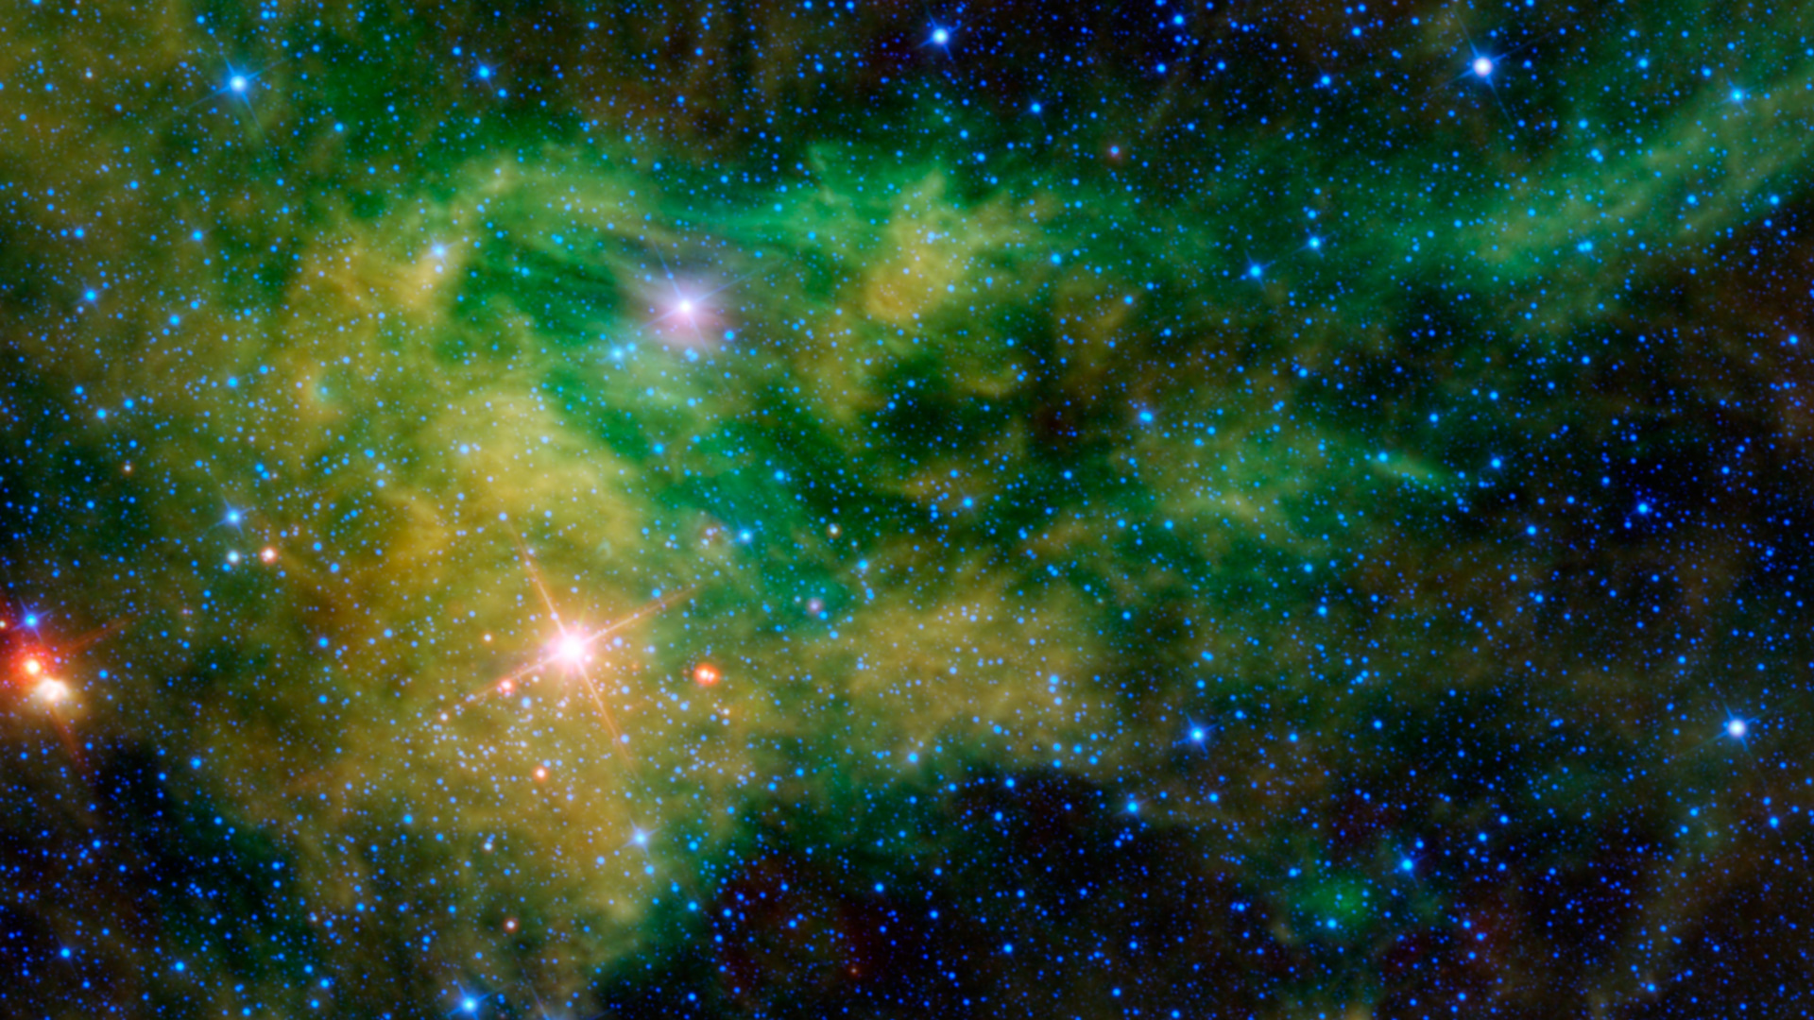
WISE Images – CE Camelopardalis

Slide 45
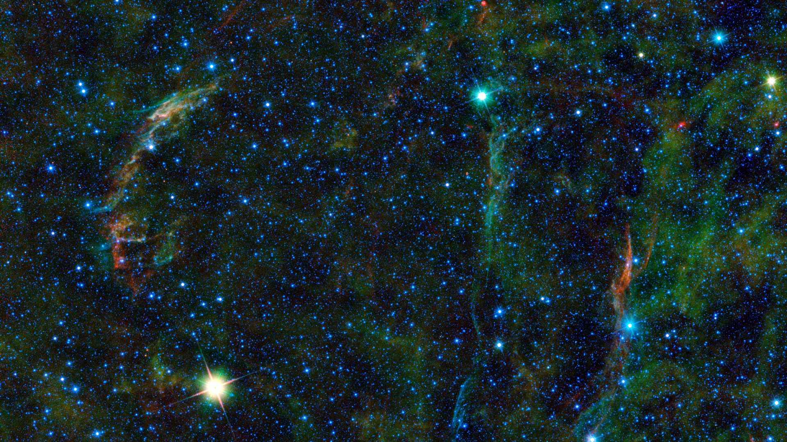
WISE Images – Veil Nebula

Slide 46
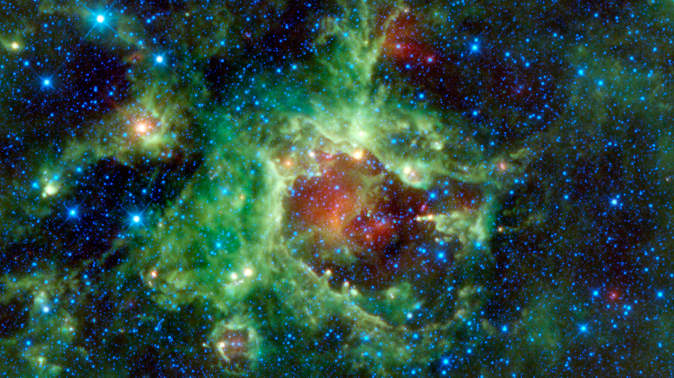
WISE Images – LBN 211.91-01.37

Slide 47
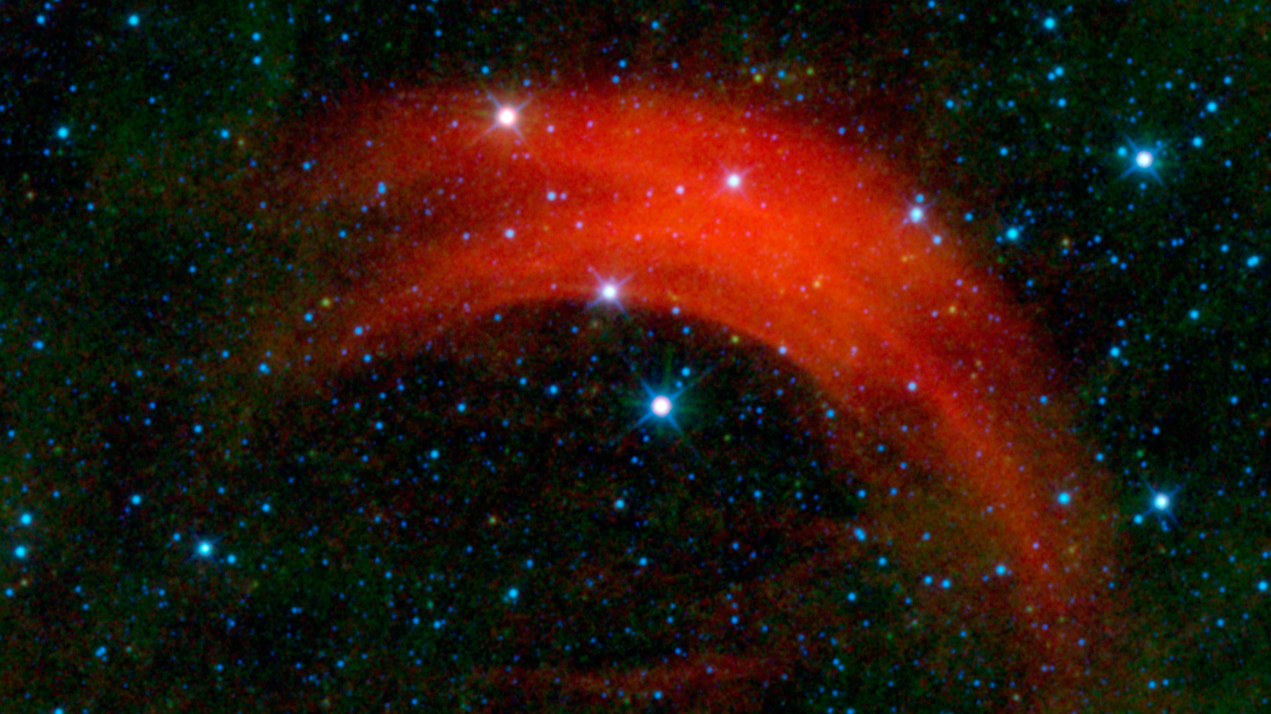
WISE Images – Alpha Camelopardalis

Slide 48
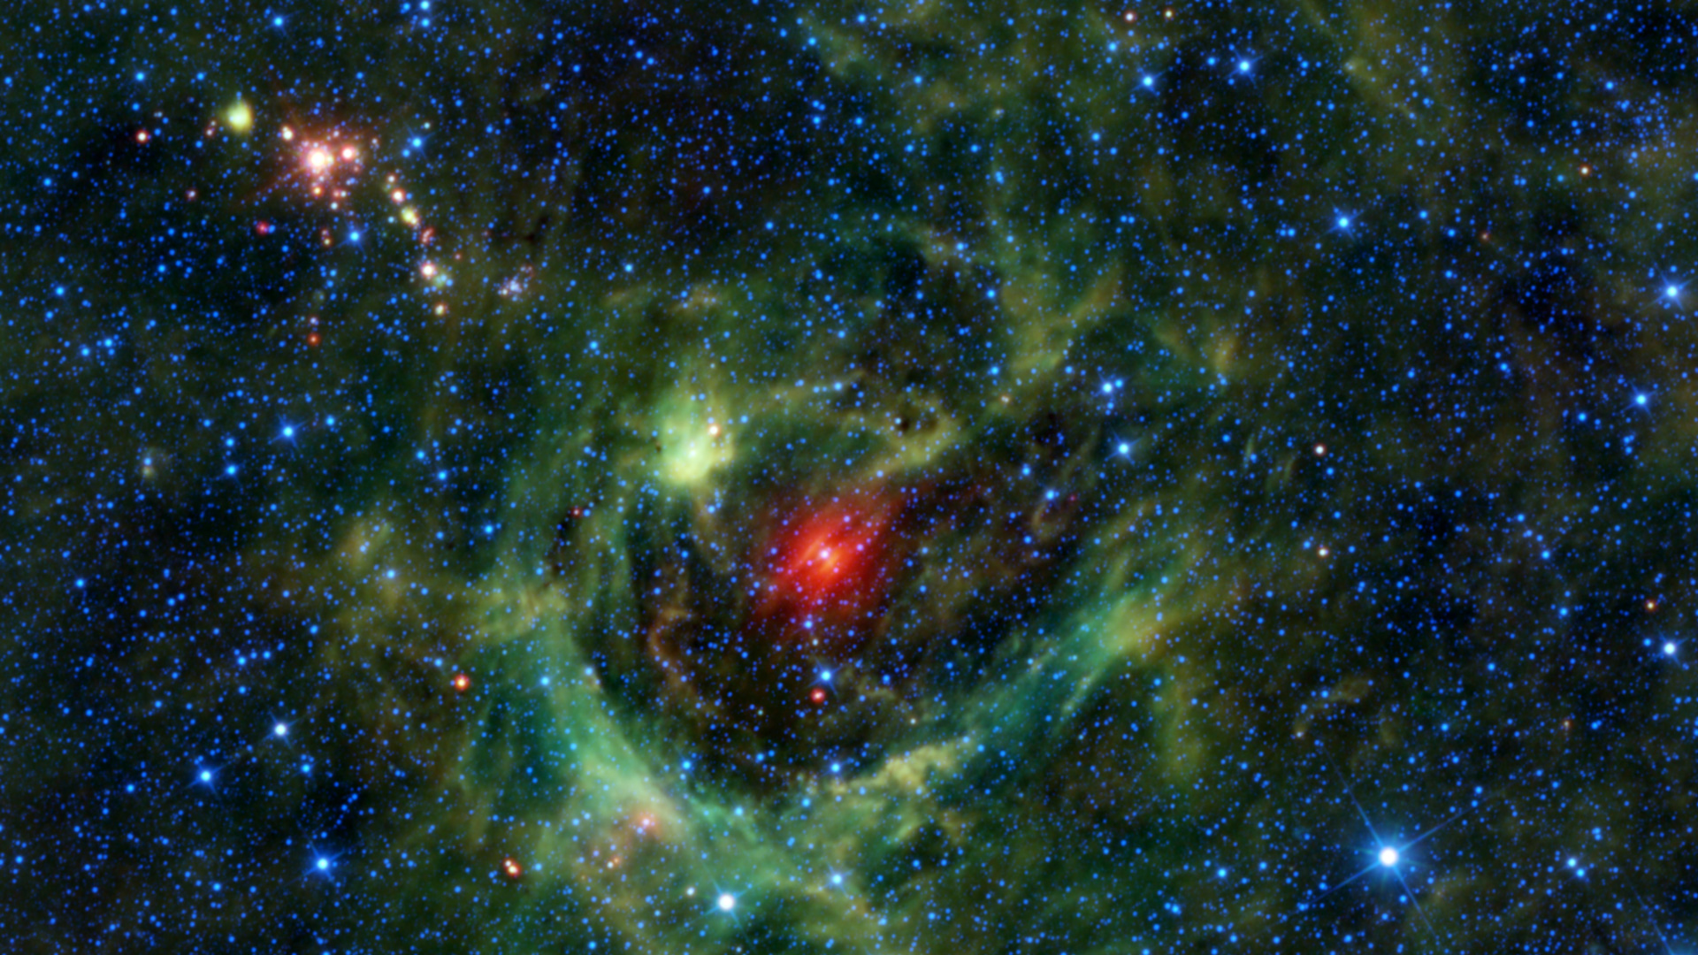
WISE Images – LBN 149.02-00.13

Slide 49
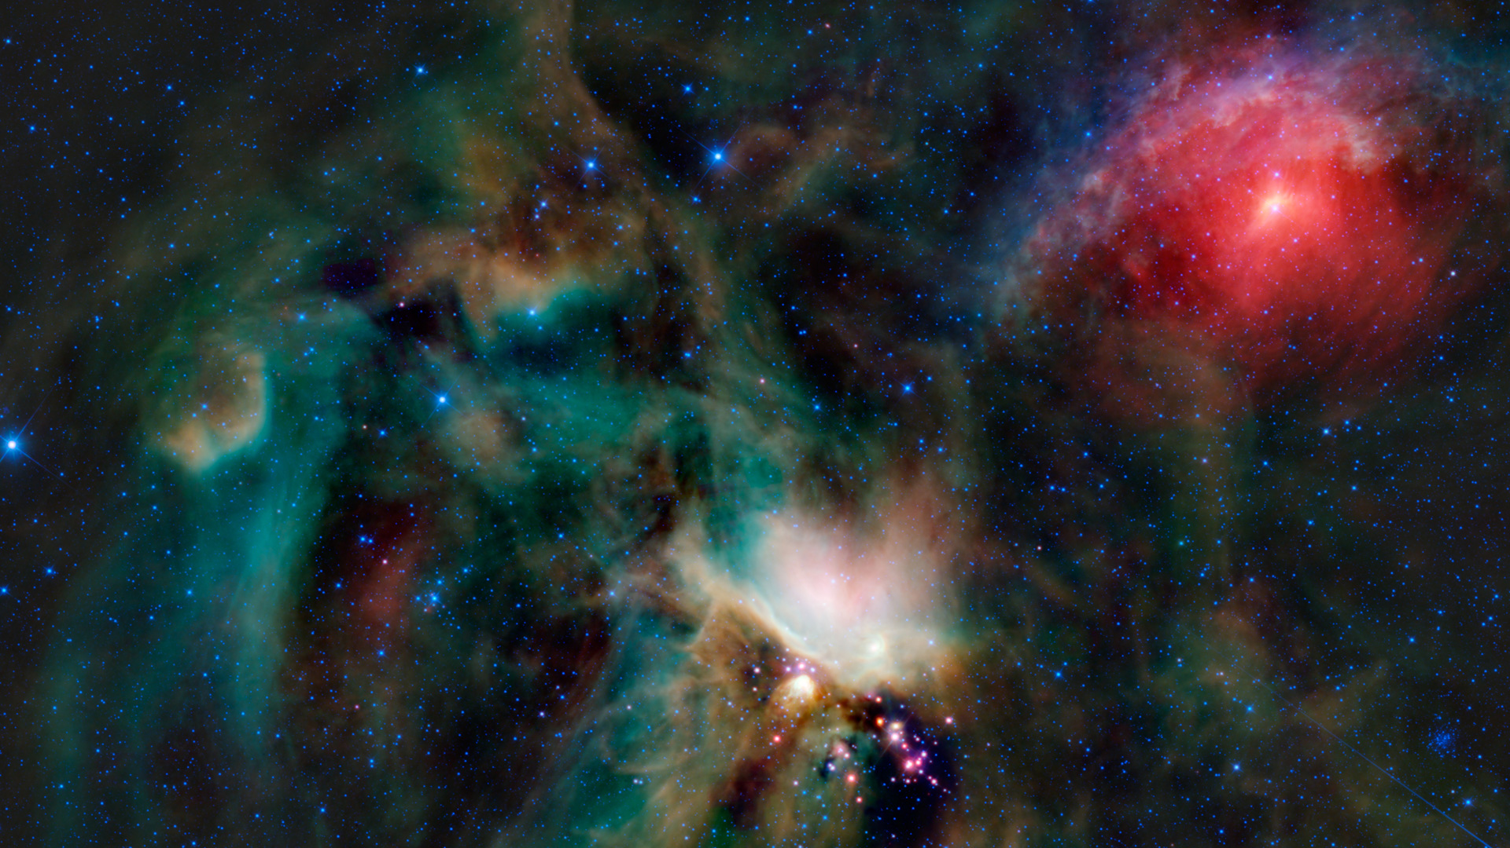
WISE Images – Rho Ophiuchi Cloud

Slide 50
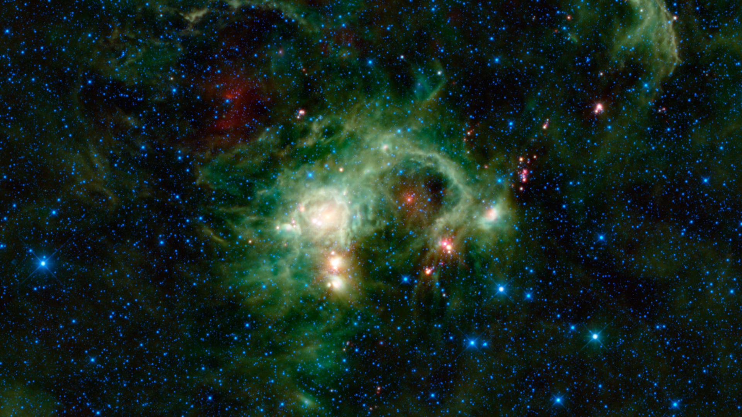
WISE Images – SH 2-235

Slide 51
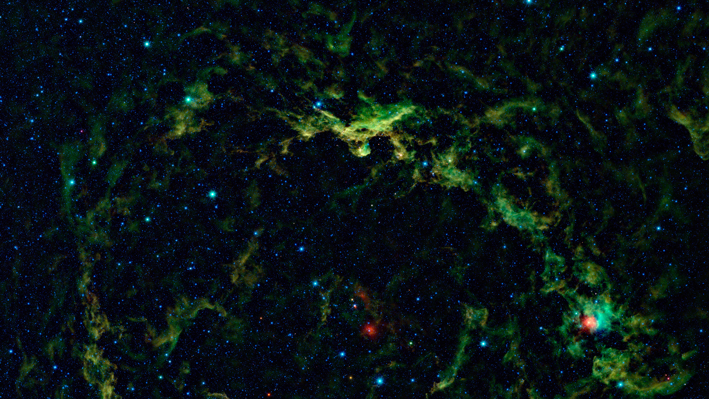
WISE Images – (upper) Lambda Orionis

Slide 52
WISE Images – (lower) Lambda Orionis

Slide 53
WISE Images – NGC 2174

Slide 54
WISE Images – NGC 1491

